Slide 1

Introduction to Machine Learning with H₂O
Overview
Company / People
Open Source H₂O Machine Learning Platform
Overview
Credit Card Default Demo
Driverless AI
Overview
Credit Card Default Demo
Q&A
Jo-fai (Joe) Chow
Data Scientist at H2O.ai
joe@h2o.ai

Slide 2

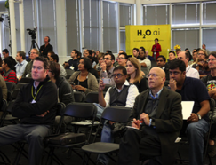




Company Overview
Founded | 2011 Venture-backed, debuted in 2012
Products | H₂O Open Source In-Memory AI Prediction Engine Sparkling Water (H₂O + Spark) Enterprise Steam Driverless AI
Mission | Operationalize Data Science, and provide a platform for users to build beautiful data products
Team | 75+ employees Distributed Systems Engineers doing Machine Learning World-class visualization designers
Headquarters | Mountain View, CA

Slide 3


Scientific Advisory Council

Slide 4

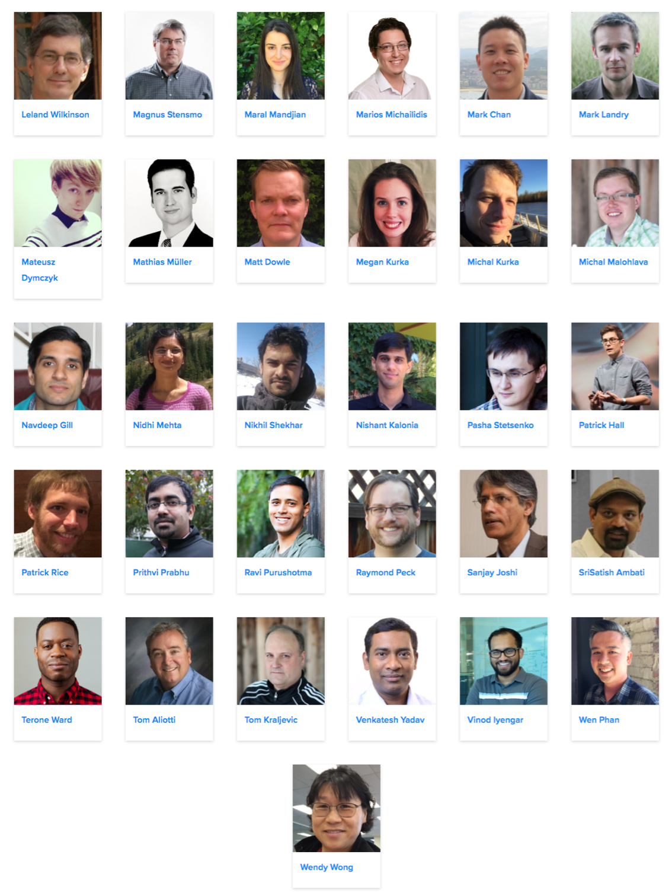
H₂O Team

Slide 5
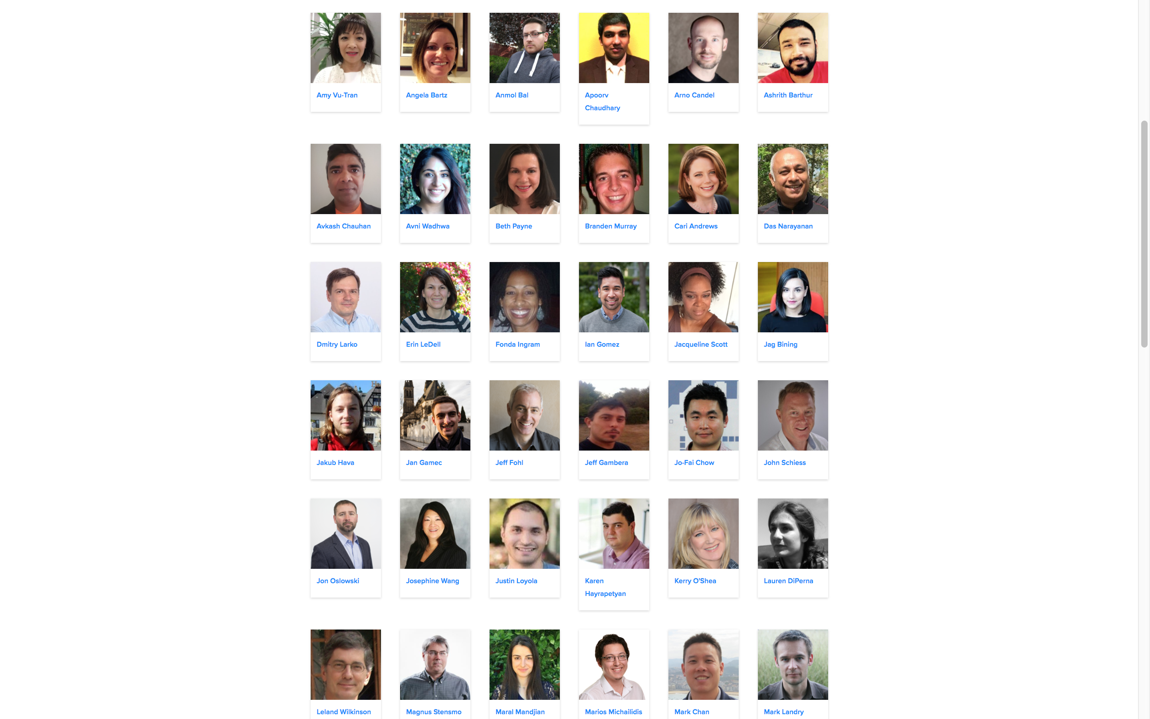
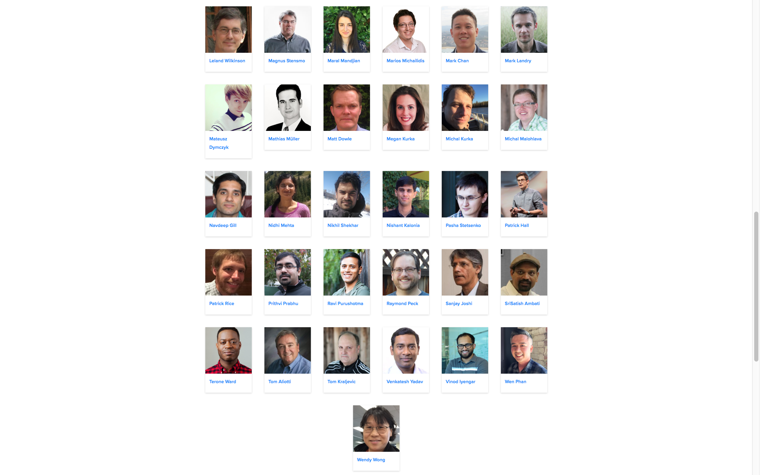

H₂O Team in Europe (2016)

Slide 6
H₂O Team in Europe (2017)
UK
Germany
Czech Rep.
UK

Slide 7

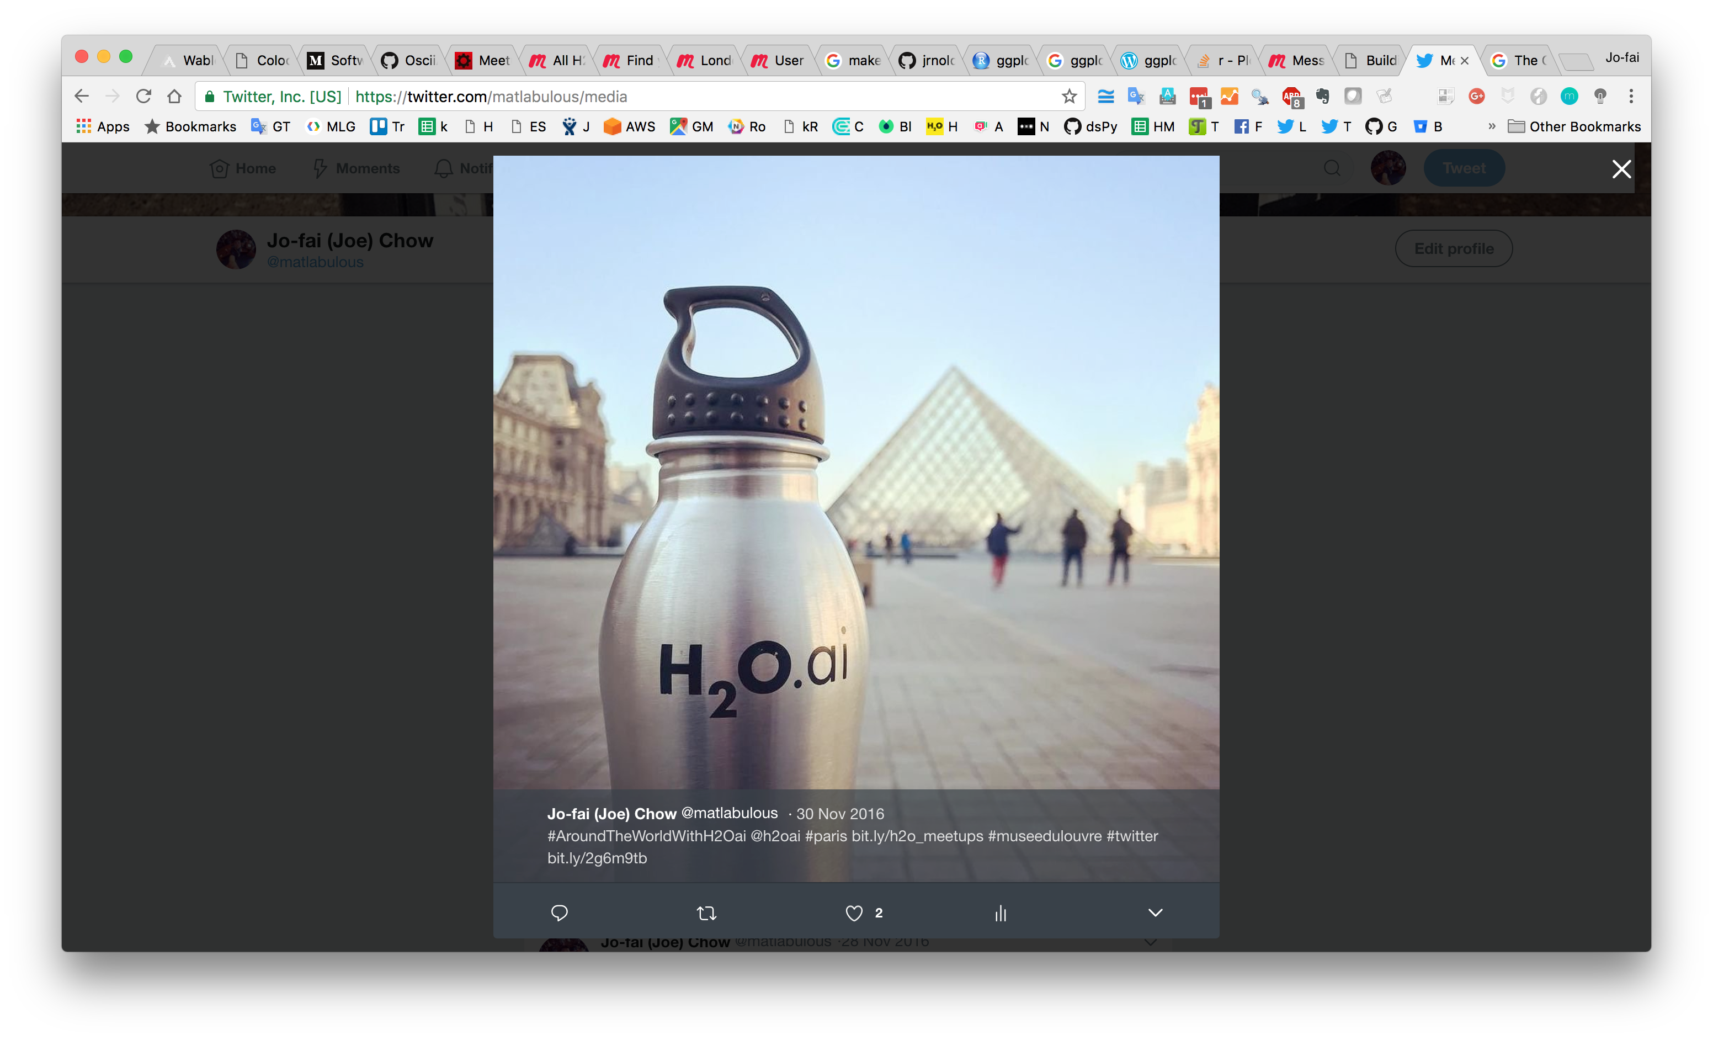
What is Joe’s role at H₂O.ai?
Data Scientist / Sales Engineer / Speaker / Meetup Organiser / Community Growth Hacker (on paper)
Unofficial Photographer of H2O.ai SWAG (the travelling data scientist)
#1 H2O.ai SWAG EMEA Distributor (what I really do …)

Slide 8

#AroundTheWorldWithH2Oai
Meetups, Workshops & Conferences in 25+ Cities
Month | Joe’s H₂O Events in 2017
Jan | London
Feb | London, Warsaw, Oxford
Mar | Bay Area, London, Cologne, Barcelona, Madrid, Vienna
Apr | Amsterdam, Rotterdam, Poznan, London
May | Belgrade, Hamburg, Berlin
Jun | Amsterdam, Stockholm, Budapest, London, Munich, Prague
Jul | Berlin, Brussels
Aug
Sep | London, Dublin
Oct | Exeter, Munich, Dublin, The Hague, Amsterdam, Frankfurt
Nov | Munich, Zurich, London, Glasgow
Dec | Bay Area, London

Slide 9
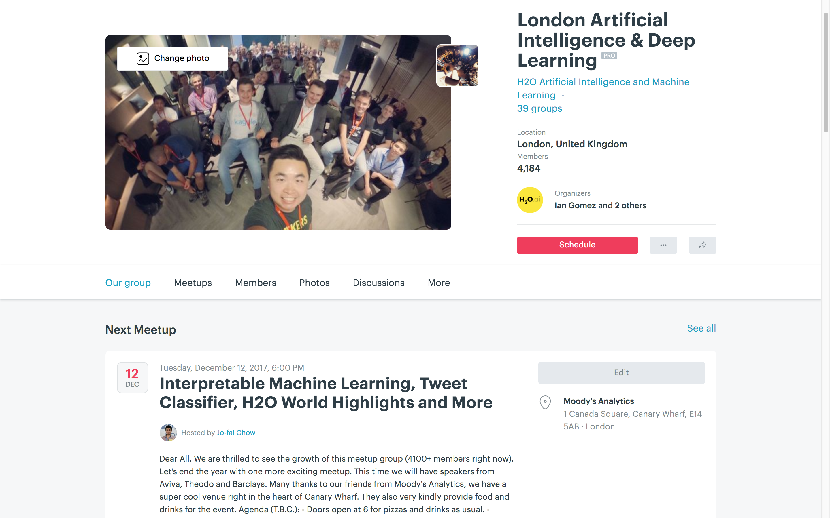
4100+ Members
Next London Meetup: 12 Dec at Moody’s London HQ

Slide 10
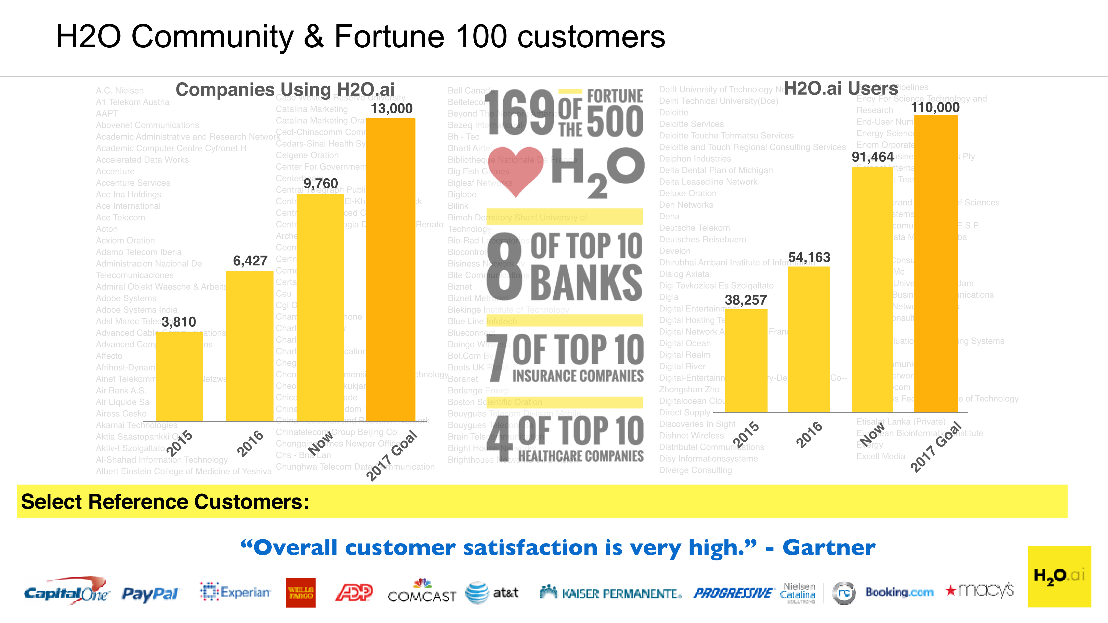
H₂O Community Growth

Slide 11

































Select Customers
Retail
Healthcare
Marketing
Financial
Advisory & Accounting
Insurance
Telecom
“Overall customer satisfaction is very high.” - Gartner
Notes:
Get a better icon for Advisory and accounting category, use the work assurance, Consider using graphs behind to scale, make it a normal curve, Horizontal, Fortune 500 customers, How many are using H2O

Slide 12







AI in Financial Services
Wholesale / Commercial Banking
IT Infrastructure
Know Your Customers (KYC)
Anti-Money Laundering (AML)
Security Cyberlake
DoS Detection and Protection
Master Data Management
Retail Banking
Card/Payments Business
Deposit Fraud
Customer Churn Prediction
Auto-Loan
Transaction Frauds
Real-time Targeting
Credit Risk Scoring
In-Context Promotion
Today’s Use Case Examples

Slide 13


Award-Winning Application (PwC + H₂O.ai)
http://www.pwc.com/gx/en/about/stories-from-across-the-world/harnessing-the-power-of-ai-to-transform-the-detection-of-fraud-and-error.html
Notes:
Works on Hadoop & Spark
Key capabilities
Distributed in-memory algorithms
Columnar compression
Feature Engineering
EDA
Data Munging
Supervised Learning Algorithms
Unsupervised Learning Algorithms
Model deployment via POJO

Slide 14
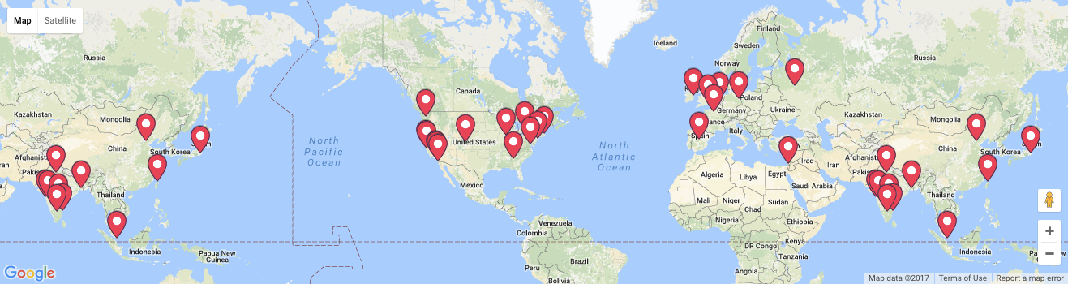

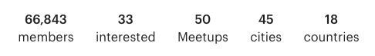

Community Expansion
15 Meetups a month
Find out more: www.h2o.ai/community/
Notes:
Note meetups groups were just opened from Feb 7-10.

Slide 15


Slide 16

H₂O Machine Learning Platform

Slide 17



High Level Architecture
HDFS
H₂O Compute Engine
S3
Load Data
Exploratory &
Descriptive
Analysis
Supervised &
Unsupervised
Modeling
Predict
Distributed
In-Memory
NFS
Feature Engineering &
Selection
Model Evaluation &
Selection
Data & Model Storage
Loss-less
Compression
Local
Data Prep Export:
Plain Old Java Object
Model Export:
Plain Old Java Object
SQL
Production Scoring Environment
Your
Imagination
Notes:
Works on Hadoop & Spark
Key capabilities
Distributed in-memory algorithms
Columnar compression
Feature Engineering
EDA
Data Munging
Supervised Learning Algorithms
Unsupervised Learning Algorithms
Model deployment via POJO

Slide 18
High Level Architecture
Import Data from Multiple Sources
HDFS
H₂O Compute Engine
S3
Load Data
Exploratory &
Descriptive
Analysis
Supervised &
Unsupervised
Modeling
Predict
Distributed
In-Memory
NFS
Feature Engineering &
Selection
Model Evaluation &
Selection
Data & Model Storage
Loss-less
Compression
Local
Data Prep Export:
Plain Old Java Object
Model Export:
Plain Old Java Object
SQL
Production Scoring Environment
Your
Imagination
Notes:
Works on Hadoop & Spark
Key capabilities
Distributed in-memory algorithms
Columnar compression
Feature Engineering
EDA
Data Munging
Supervised Learning Algorithms
Unsupervised Learning Algorithms
Model deployment via POJO

Slide 19
Supported Formats & Data Sources
File type or Folder of Files
CSV
XLS
XLSX
ORC*
Hive*
SVMLight
ARFF
Parquet
Avro 1.8.0*
HDFS
9 Formats
5 Sources
S3
NFS
LOCAL
SQL
* 1. only if H2O is running as a Hadoop job
* 2. Hive files that are saved in ORC format
* 3. without multi-file parsing or column type modification
Notes:
With the H2O integration for Hadoop you can import a whole range of different file formats including ….
If you have a directory of files with the same shape and labeling you can simply point to the directory path and H2O will combine all
those datasets into a single frame. This is particularly helpful if you use Hive because Hive queries result in lots of part files save to one big directory.
These supported file types can be ingested from any of the following data sources ...
CSV (delimited) files
ORC only if H2O is running as a Hadoop job.
SVMLight
ARFF
XLS
XLSX
Avro version 1.8.0 (without multifile parsing or column type modification)
Parquet
Hive files that are saved in ORC format.

Slide 20
High Level Architecture
Fast, Scalable & Distributed Compute Engine Written in Java
HDFS
H₂O Compute Engine
S3
Load Data
Exploratory &
Descriptive
Analysis
Supervised &
Unsupervised
Modeling
Predict
Distributed
In-Memory
NFS
Feature Engineering &
Selection
Model Evaluation &
Selection
Data & Model Storage
Loss-less
Compression
Local
Data Prep Export:
Plain Old Java Object
Model Export:
Plain Old Java Object
SQL
Production Scoring Environment
Your
Imagination
Notes:
Works on Hadoop & Spark
Key capabilities
Distributed in-memory algorithms
Columnar compression
Feature Engineering
EDA
Data Munging
Supervised Learning Algorithms
Unsupervised Learning Algorithms
Model deployment via POJO

Slide 21
High Level Architecture
Distributed Algorithms
HDFS
H₂O Compute Engine
S3
Load Data
Exploratory &
Descriptive
Analysis
Supervised &
Unsupervised
Modeling
Predict
Distributed
In-Memory
NFS
Feature Engineering &
Selection
Model Evaluation &
Selection
Data & Model Storage
Loss-less
Compression
Local
Data Prep Export:
Plain Old Java Object
Model Export:
Plain Old Java Object
SQL
Production Scoring Environment
Your
Imagination
Notes:
Works on Hadoop & Spark
Key capabilities
Distributed in-memory algorithms
Columnar compression
Feature Engineering
EDA
Data Munging
Supervised Learning Algorithms
Unsupervised Learning Algorithms
Model deployment via POJO

Slide 22

Distributed Algorithms
Advantageous Foundation
Foundation for In-Memory Distributed Algorithm Calculation - Distributed Data Frames and columnar compression
All algorithms are distributed in H₂O: GBM, GLM, DRF, Deep Learning and more. Fine-grained map-reduce iterations.
Only enterprise-grade, open-source distributed algorithms in the market
Parallel Parse into Distributed Rows
Foundation for Distributed Algorithms
User Benefits
“Out-of-box” functionalities for all algorithms (NO MORE SCRIPTING) and uniform interface across all languages: R, Python, Java
Designed for all sizes of data sets, especially large data
Highly optimized Java code for model exports
In-house expertise for all algorithms
Fine Grain Map Reduce Illustration: Scalable Distributed Histogram Calculation for GBM
Notes:
GBM authors from Stanford on Scientific Advisory Council

Slide 23
Algorithms Overview
Supervised Learning
Unsupervised Learning
Statistical Analysis
Generalized Linear Models: Binomial, Gaussian, Gamma, Poisson and Tweedie
Naïve Bayes
K-means: Partitions observations into k clusters/groups of the same spatial size. Automatically detect optimal k
Clustering
Distributed Random Forest: Classification or regression models
Gradient Boosting Machine: Produces an ensemble of decision trees with increasing refined approximations
Principal Component Analysis: Linearly transforms correlated variables to independent components
Generalized Low Rank Models: extend the idea of PCA to handle arbitrary data consisting of numerical, Boolean, categorical, and missing data
Dimensionality Reduction
Ensembles
Deep Neural Networks
Deep learning: Create multi-layer feed forward neural networks starting with an input layer followed by multiple layers of nonlinear transformations
Anomaly Detection
Autoencoders: Find outliers using a nonlinear dimensionality reduction using deep learning

Slide 24
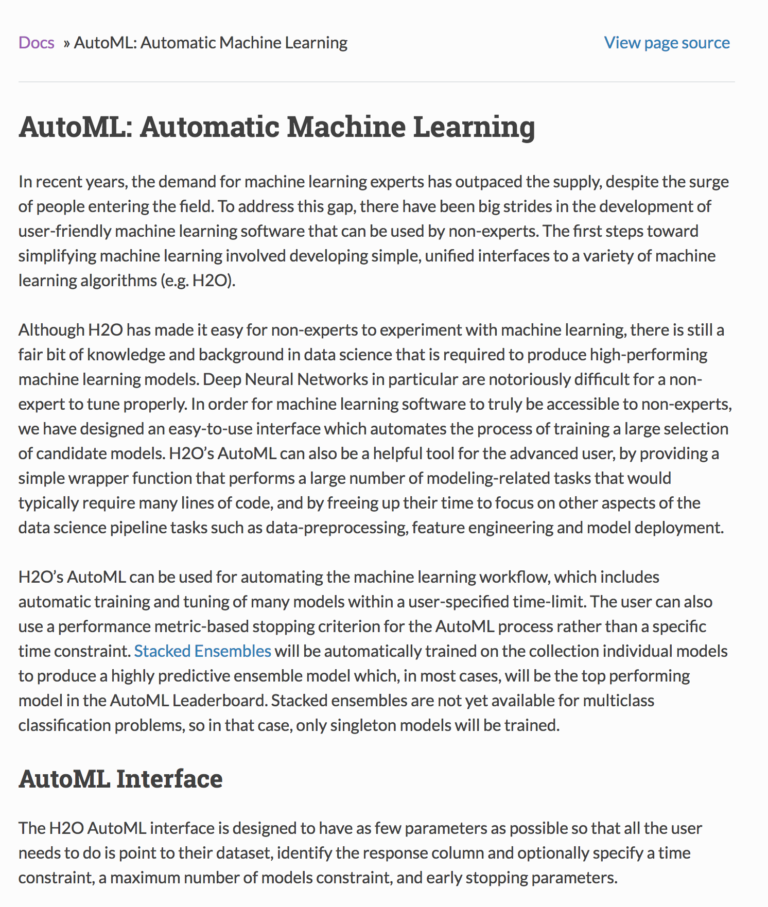

Slide 25
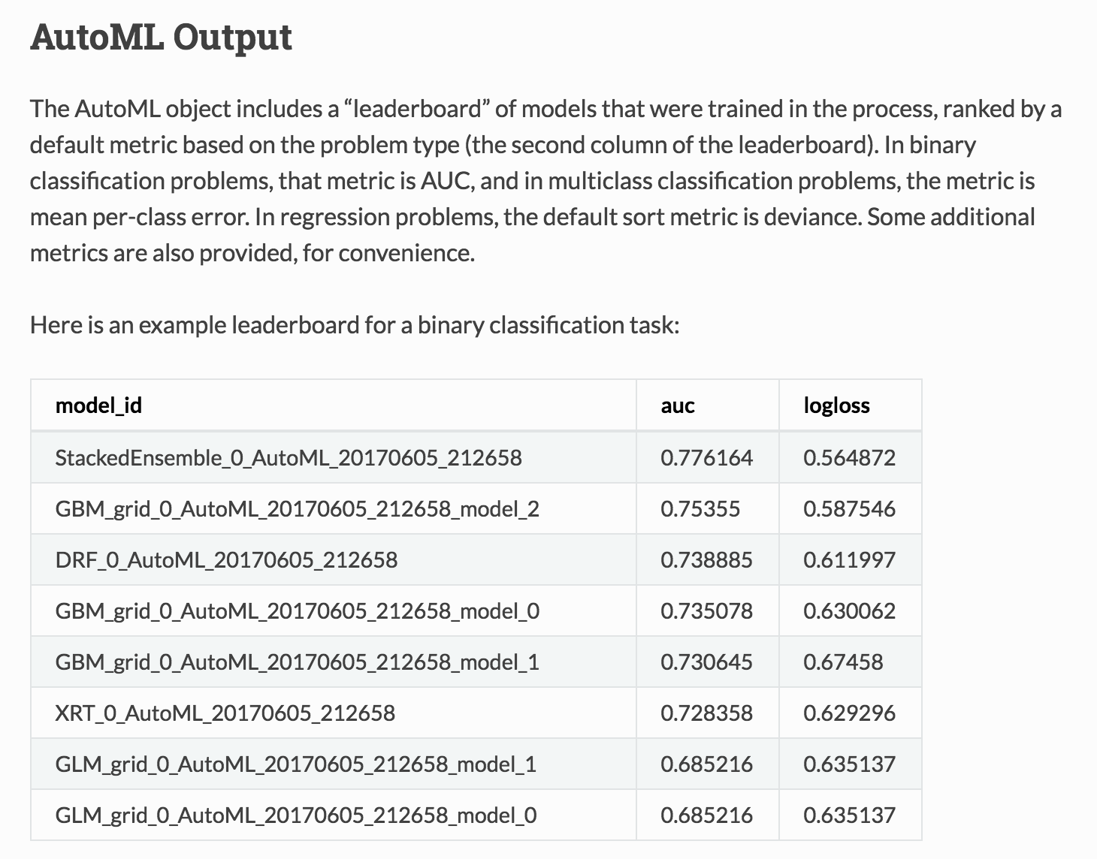

Slide 26

H₂O Core
H2O

Slide 27




H₂O Core
Model Building
CPU

Slide 28
H₂O Core
H2O
H2O
H2O

Slide 29
H₂O Core
Model Building
H2O Distributed In-Memory
CPU
CPU
CPU

Slide 30







H₂O Core
Model Building
SQL
NFS
H2O Distributed In-Memory
S3
CPU
CPU
CPU
YARN

Slide 31
H₂O Core
Firewall or Cloud
Model Building
SQL
NFS
H2O Distributed In-Memory
S3
CPU
CPU
CPU
YARN

Slide 32
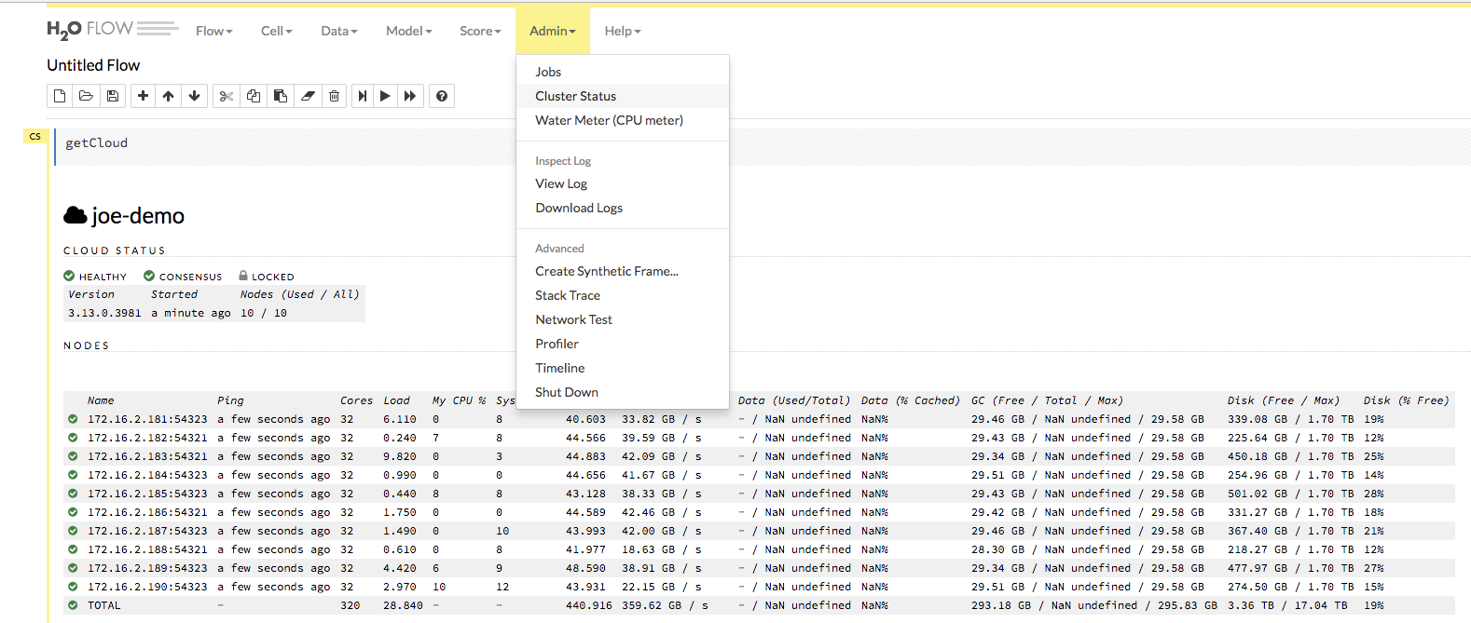
10 nodes
10 x 32 = 320 Cores
10 x 29.6 = 296 GB Memory

Slide 33
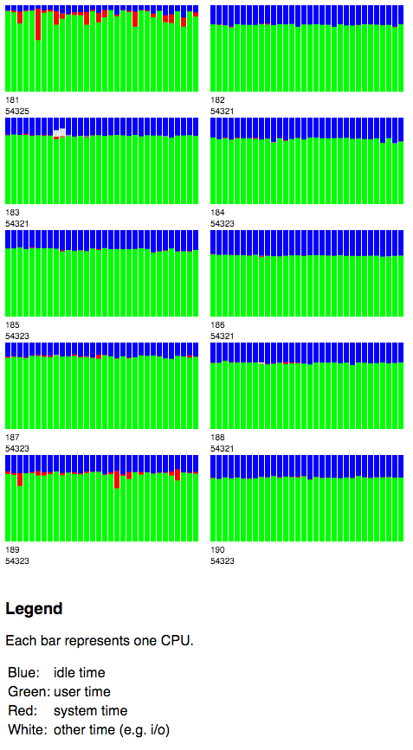
H₂O Water Meter (CPU Monitor)
10 x 32 = 320 Cores

Slide 34
High Level Architecture
Multiple Interfaces
HDFS
H₂O Compute Engine
S3
Load Data
Exploratory &
Descriptive
Analysis
Supervised &
Unsupervised
Modeling
Predict
Distributed
In-Memory
NFS
Feature Engineering &
Selection
Model Evaluation &
Selection
Data & Model Storage
Loss-less
Compression
Local
Data Prep Export:
Plain Old Java Object
Model Export:
Plain Old Java Object
SQL
Production Scoring Environment
Your
Imagination
Notes:
Works on Hadoop & Spark
Key capabilities
Distributed in-memory algorithms
Columnar compression
Feature Engineering
EDA
Data Munging
Supervised Learning Algorithms
Unsupervised Learning Algorithms
Model deployment via POJO

Slide 35
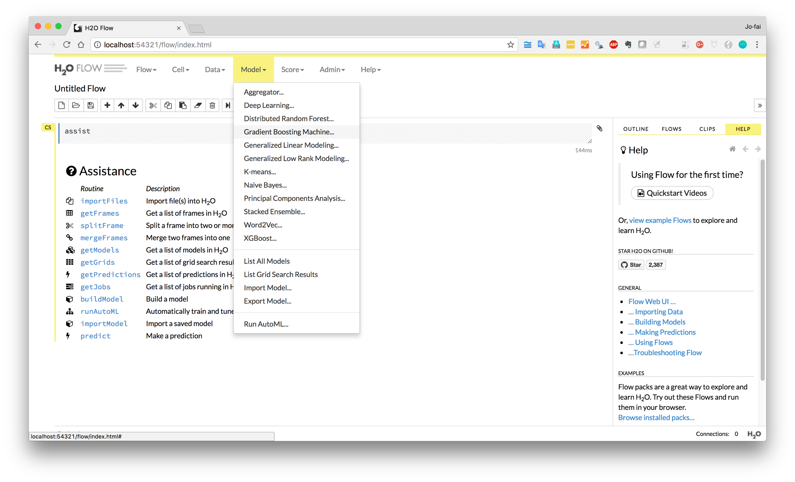
H₂O Flow (Web)

Slide 36
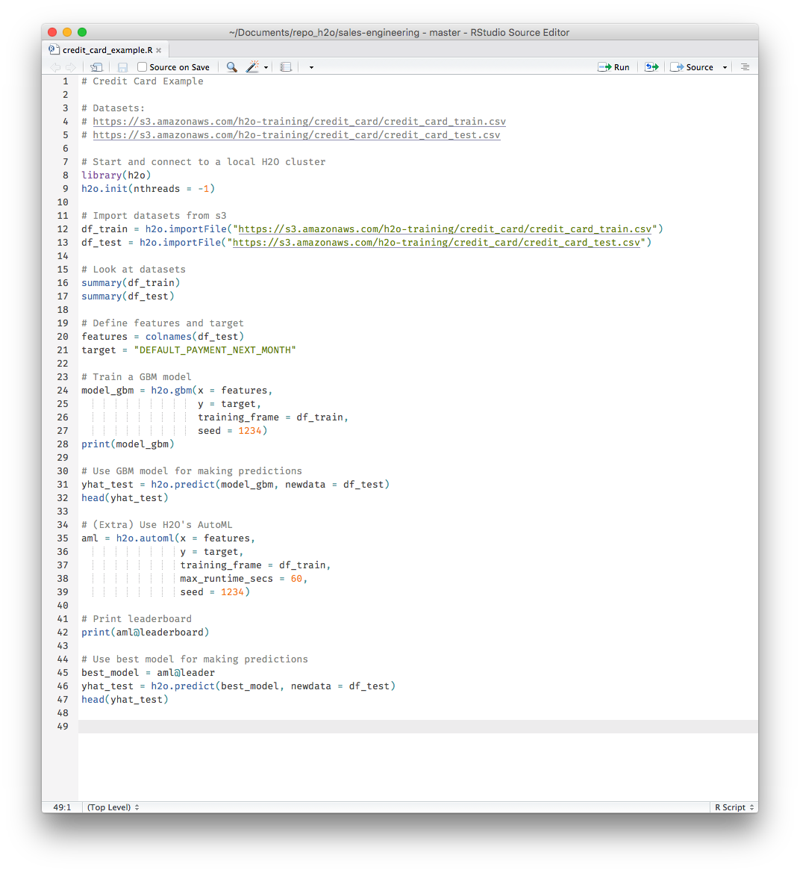
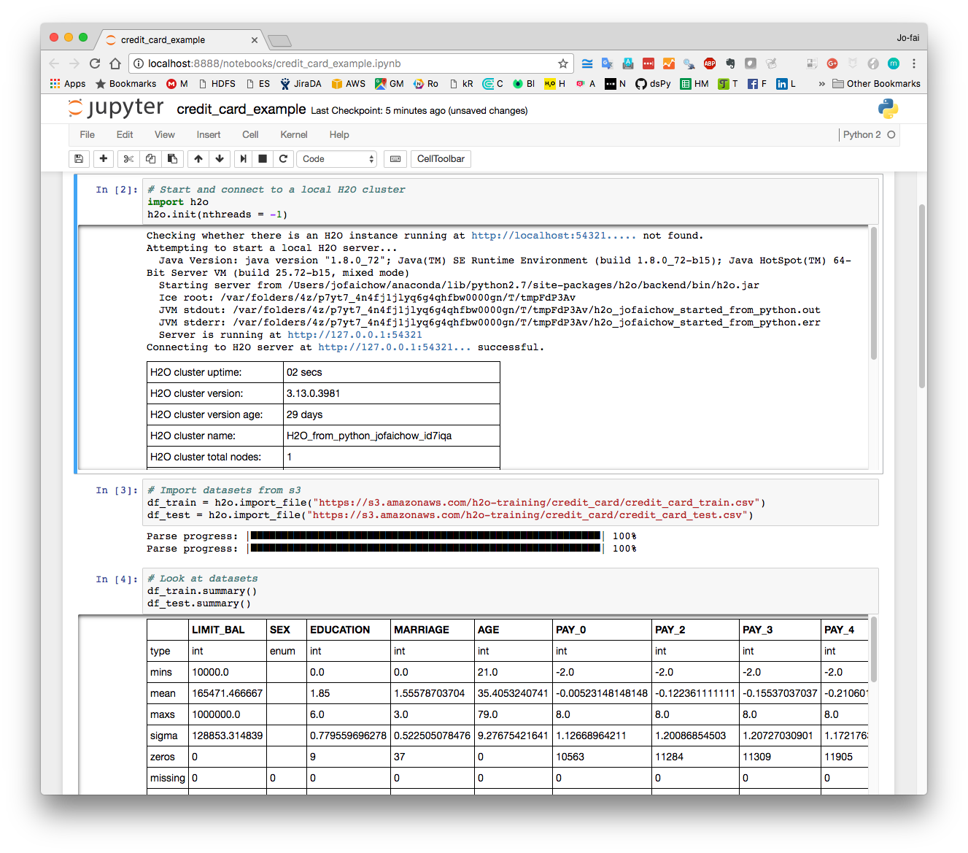
Using H₂O with R and Python

Slide 37
High Level Architecture
Export Standalone Models for Production
HDFS
H₂O Compute Engine
S3
Load Data
Exploratory &
Descriptive
Analysis
Supervised &
Unsupervised
Modeling
Predict
Distributed
In-Memory
NFS
Feature Engineering &
Selection
Model Evaluation &
Selection
Data & Model Storage
Loss-less
Compression
Local
Data Prep Export:
Plain Old Java Object
Model Export:
Plain Old Java Object
SQL
Production Scoring Environment
Your
Imagination
Notes:
Works on Hadoop & Spark
Key capabilities
Distributed in-memory algorithms
Columnar compression
Feature Engineering
EDA
Data Munging
Supervised Learning Algorithms
Unsupervised Learning Algorithms
Model deployment via POJO

Slide 38
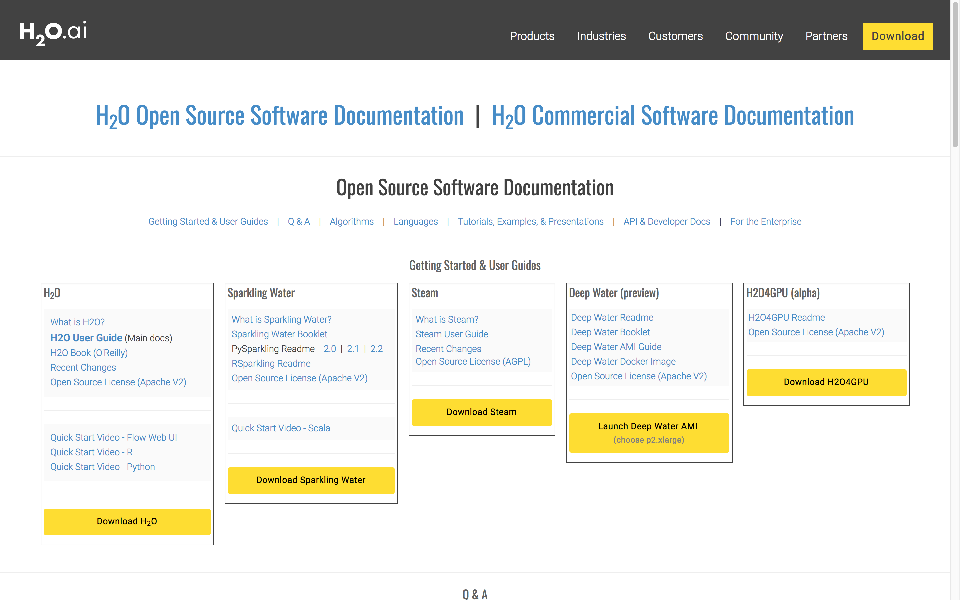
docs.h2o.ai

Slide 39
Credit Card Demo

Slide 40
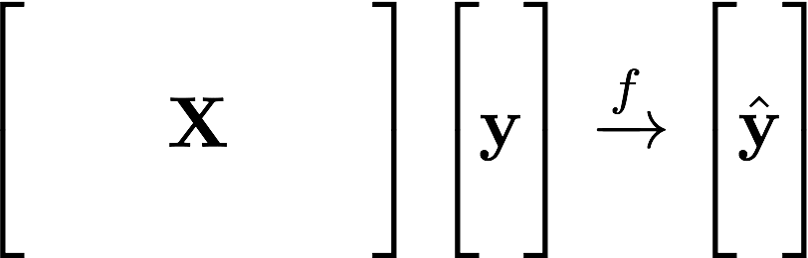
Learning from Data
Learn the Pattern
Historical
Value
Predicted
Value
Data Inputs

Slide 41
Supervised Learning
Regression:
How much will a customers spend?
Classification:
Will a customer make a purchase? Yes or No
yes
no
y
x_{j}
X
x_{i}
H₂O algos:
Penalized Linear Models
Random Forest
Gradient Boosting
Neural Networks
Stacked Ensembles
H₂O algos:
Penalized Linear Models
Naïve Bayes
Random Forest
Gradient Boosting
Neural Networks
Stacked Ensembles

Slide 42
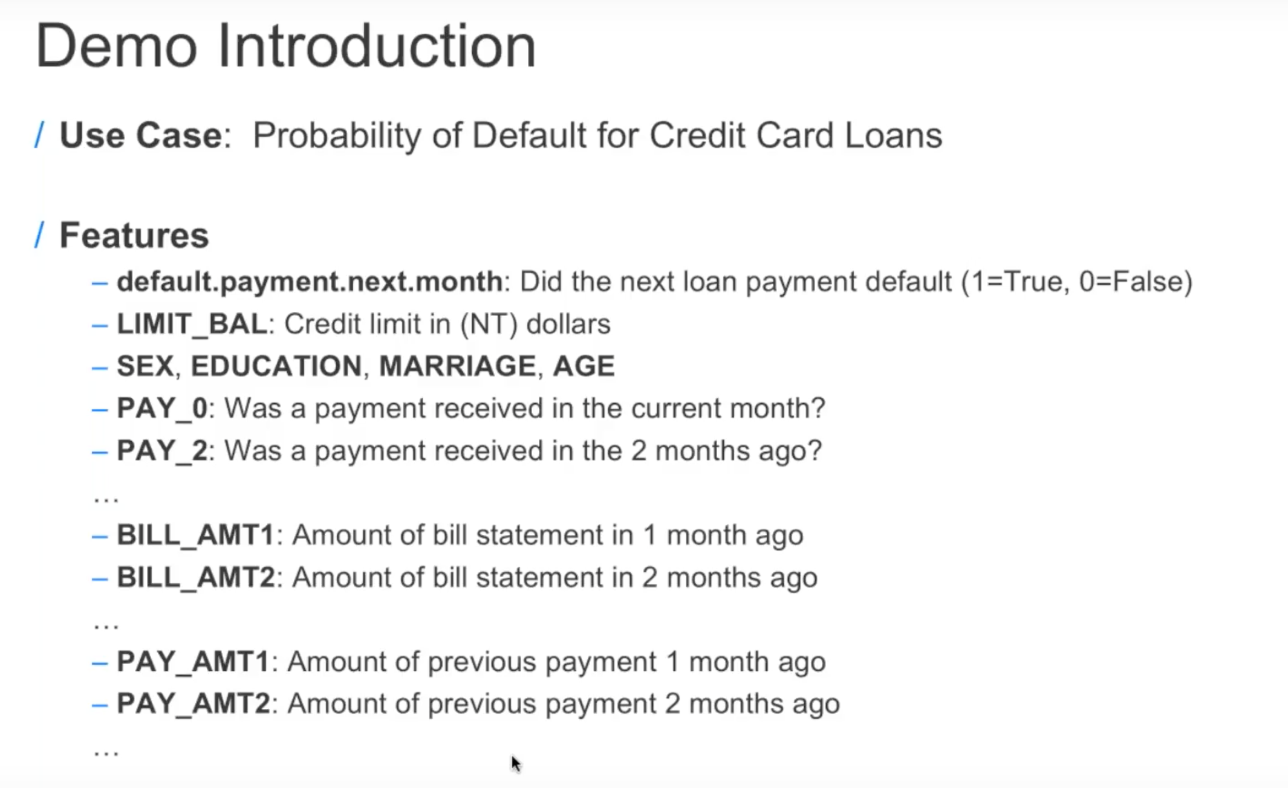

Slide 43
Learning from Credit Card Data
Learn the Pattern
Credit card info,
customer info,
payment history
Historical Outcome
Default (Yes/No)
Predicted Outcome

Slide 44
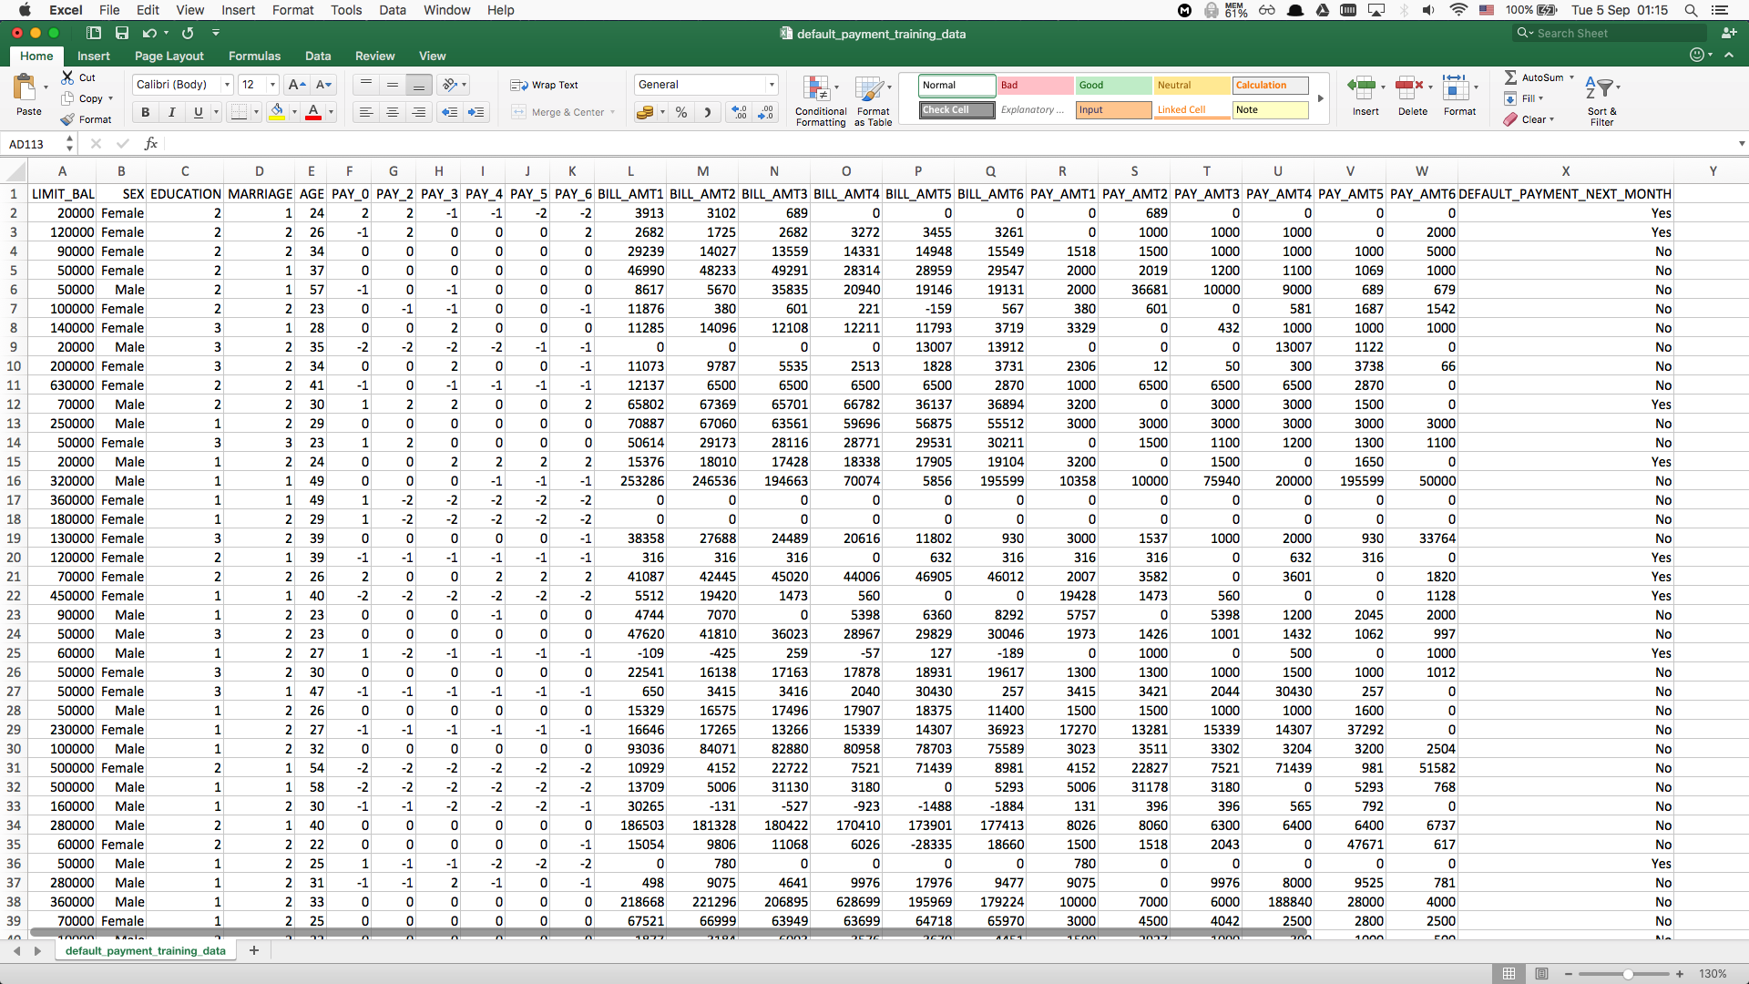
credit_card_train.csv
Data Inputs (x): credit card limit balance, customer info (sex, education, marriage, age),
payment history (six months)
Learn the Pattern
Historical Outcome (y):
Default Credit Card Payment after six months?
(Yes / No)

Slide 45
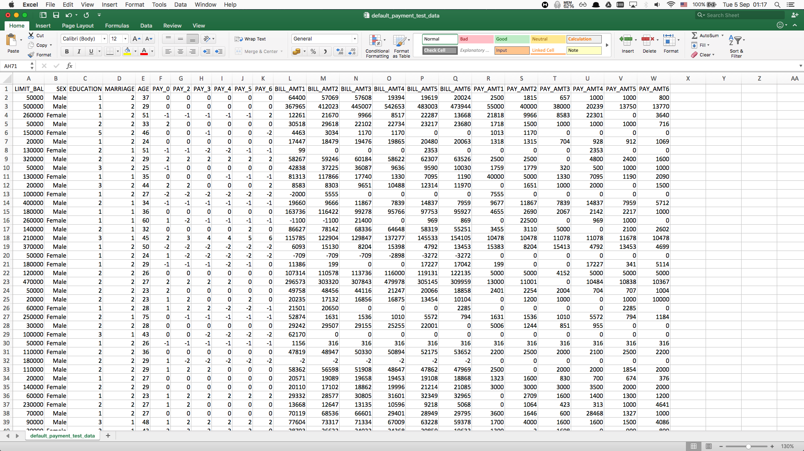
credit_card_test.csv
Data Inputs (x) only – no outcome data
(as if this is the data from new customers)
We use this dataset to make prediction
Make
Predictions
Probability of Default Payments
(Decision Makers to Take Actions)

Slide 46
Live Demo
Import and explore credit card dataset
Train a gradient boosting model and make predictions
Train many models using AutoML and make predictions using the best model

Slide 47
Driverless AI
Using AI to do AI

Slide 48
H₂O AI Platform Timeline
Visual Interpretation
H2O
Driverless AI
Analysts
Auto ML
App Developers
Deep Water
Dev Ops
Steam
Developers/Engineers
Data.table
Sparkling Water
Advanced Data Scientists
H2O GPU Edition
H2O Core
GPU
Users
2012
2014
2016
2017
2018
2019
Roadmap

Slide 49
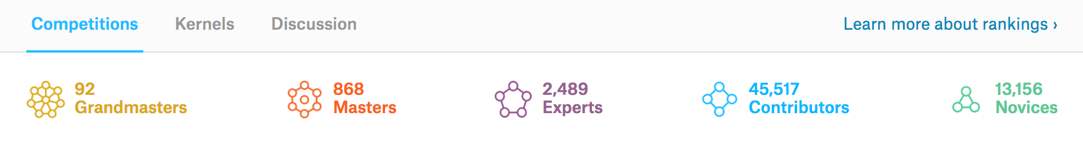
Shortage of Data Scientists
“The United States alone faces a shortage of 140,000 to 190,000 people with analytical expertise and 1.5 million managers and analysts”
–McKinsey Prediction for 2018

Slide 50
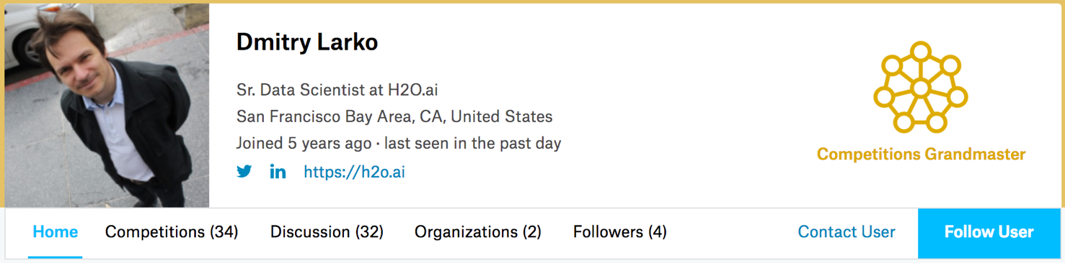
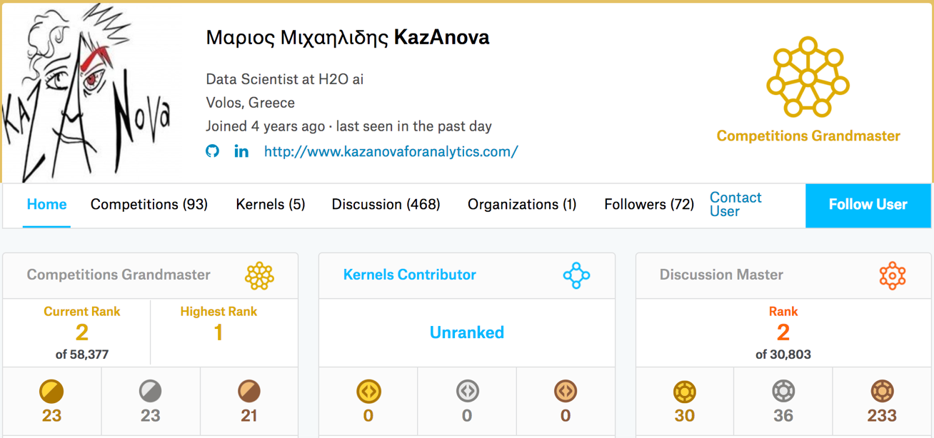

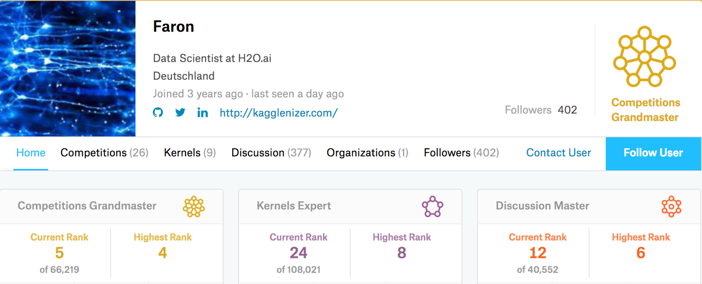

Kaggle Masters at H₂O.ai

Slide 51
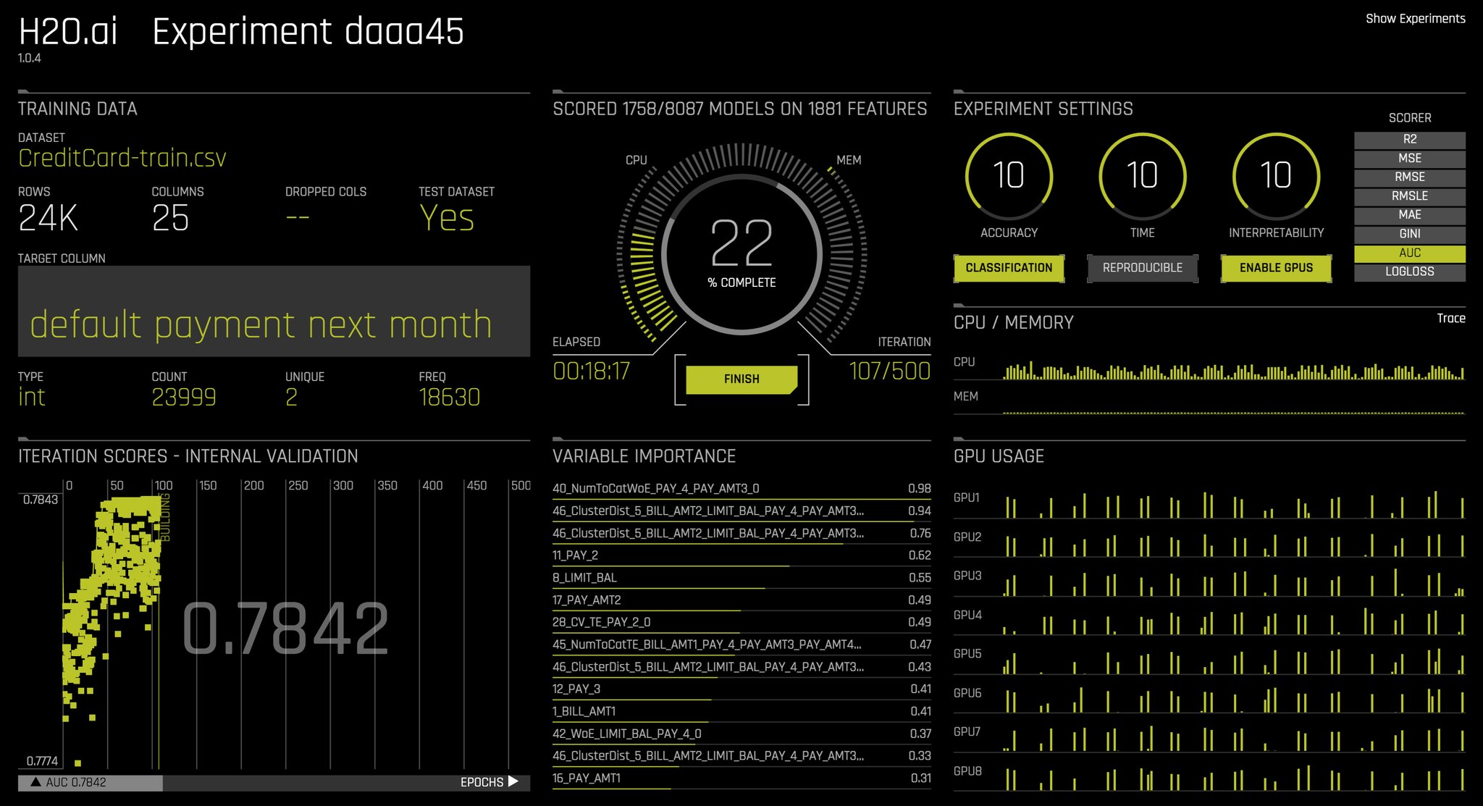
The Product: Driverless AI
Kaggle Grandmasters in a Box
A solution to the shortage of data scientists
Fast
H₂O Algorithms optimised for GPUs
Accurate
Auto Feature Engineering
Auto Model Tuning / Selection / Ensemble
Interpretable
Machine Learning Interpretation
Production Ready
Export pipeline as a standalone Python package

Slide 52
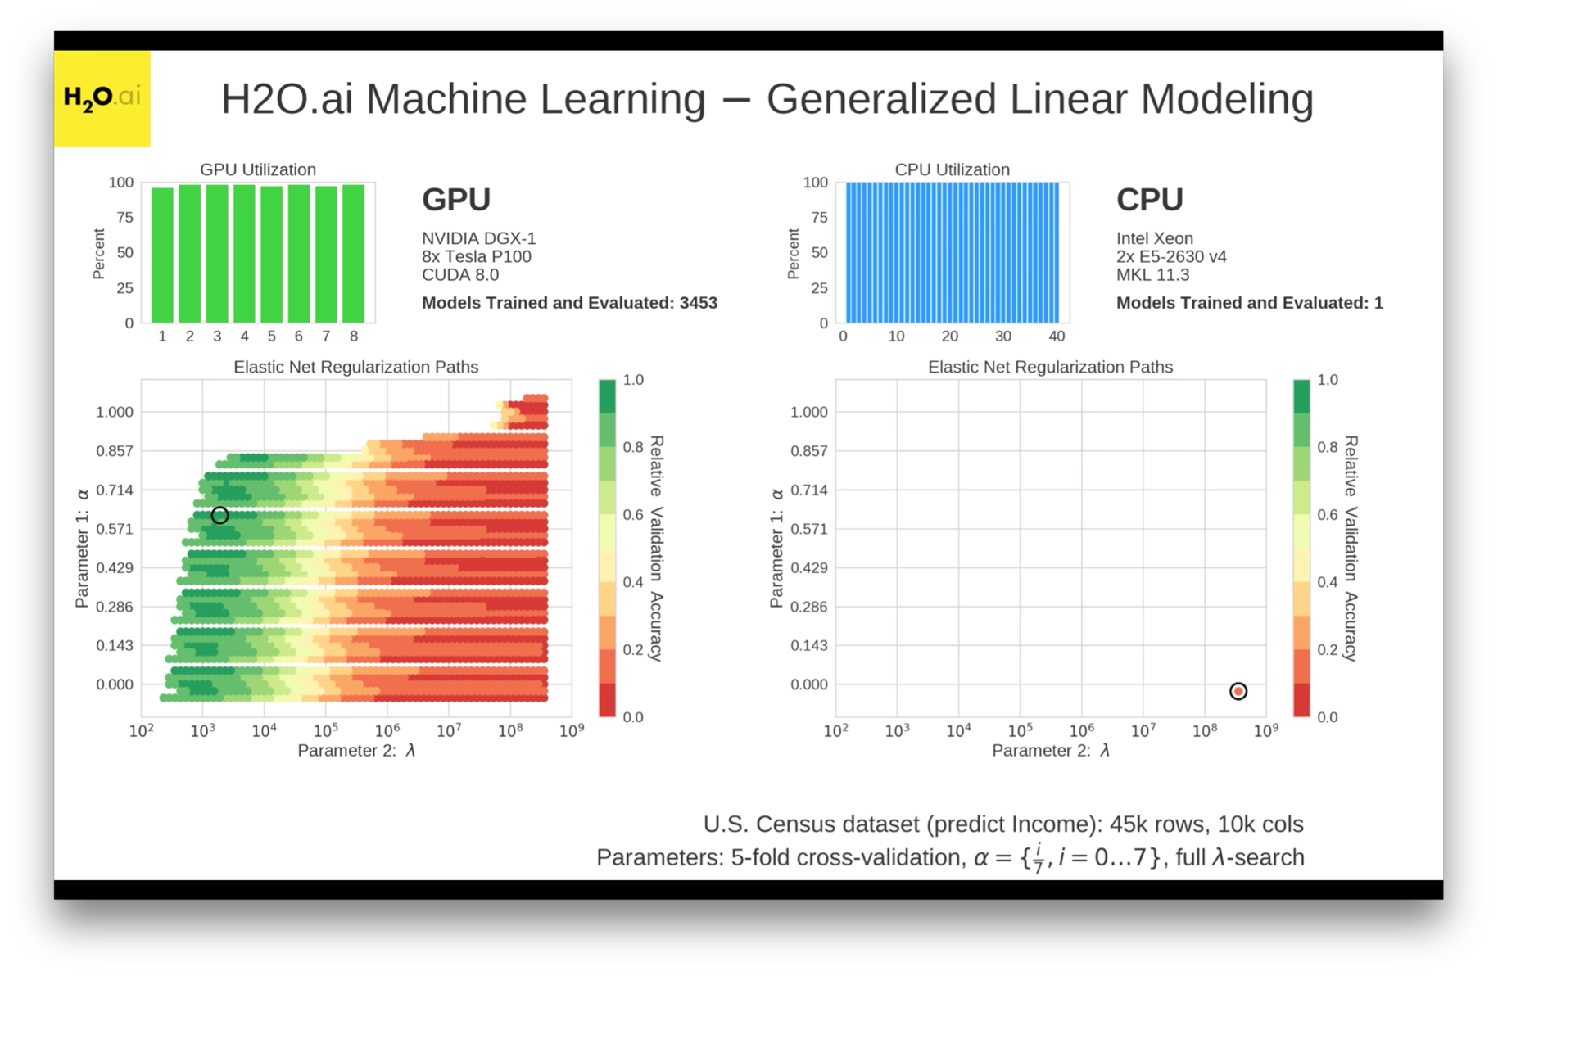
Fast: H₂O Algorithms on GPUs
3400+ models were trained on GPUs by the time the first model completed training on CPUs
https://www.youtube.com/watch?v=LrC3mBNG7WU

Slide 53




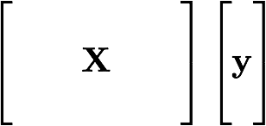
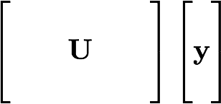
Accurate: Auto Feature Engineering
Feature Transformation
Pipeline
Feature Engineering
Model
Training

Slide 54
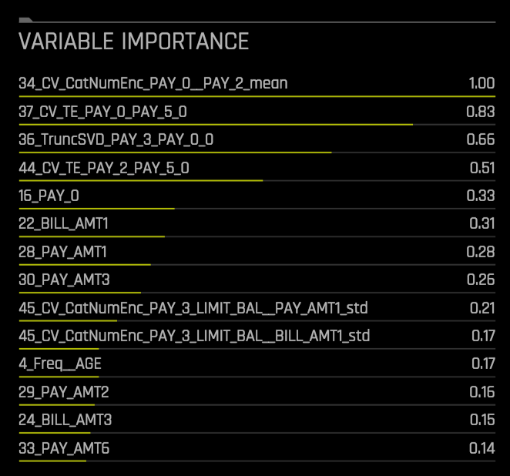
Accurate: Auto Feature Engineering
Feature Transformations
Generated Features
Cross Validation Categorical Encoding
Frequency Encoding
Cross Validation Target Encoding
Truncated SVD and More
Original Features

Slide 55
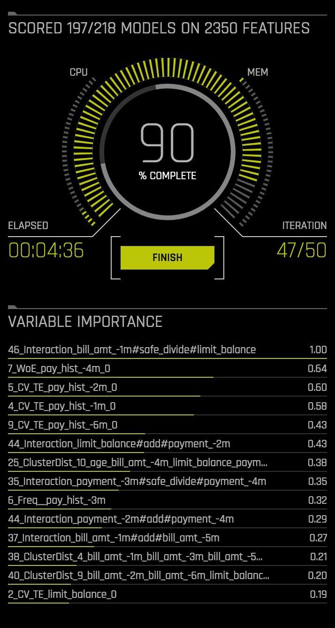
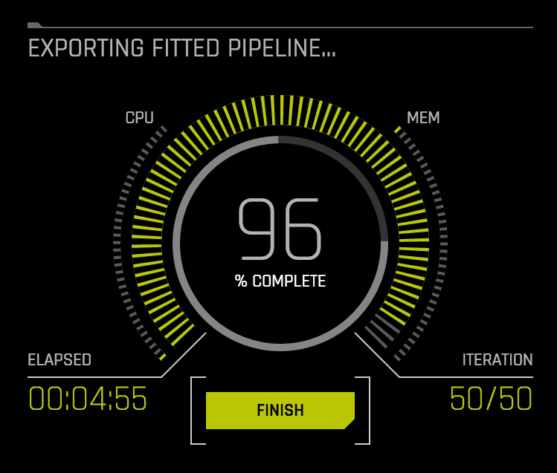
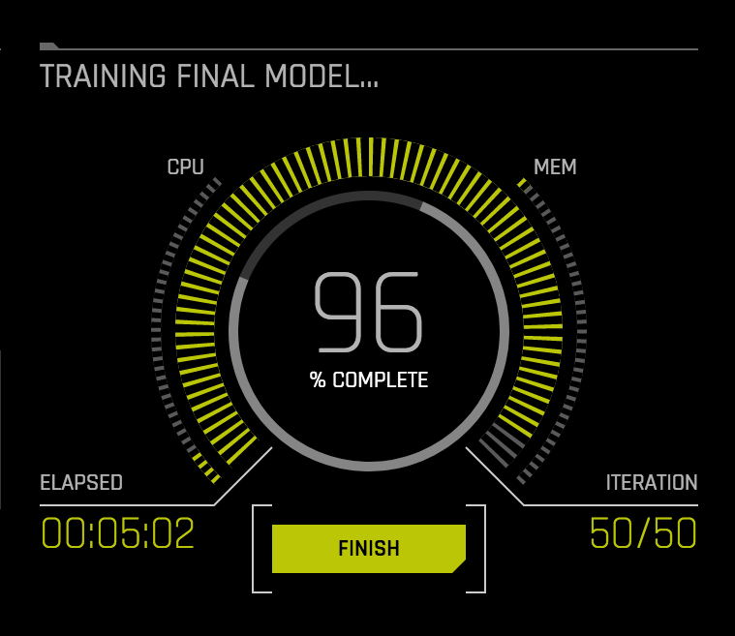
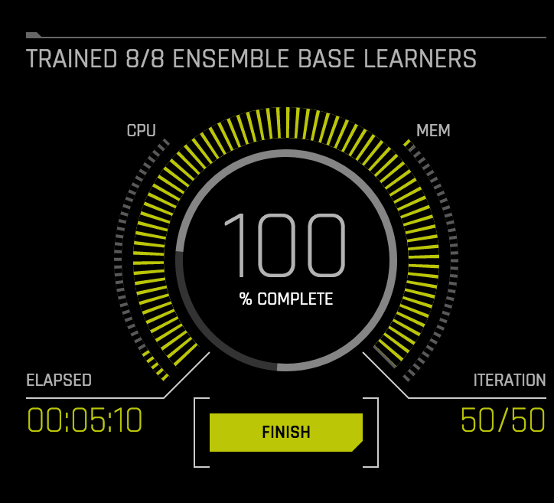
Accurate: Auto Model Tuning/Selection/Ensemble

Slide 56
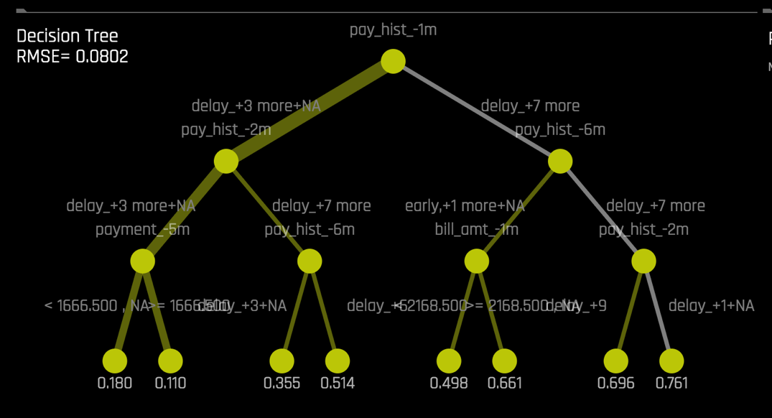
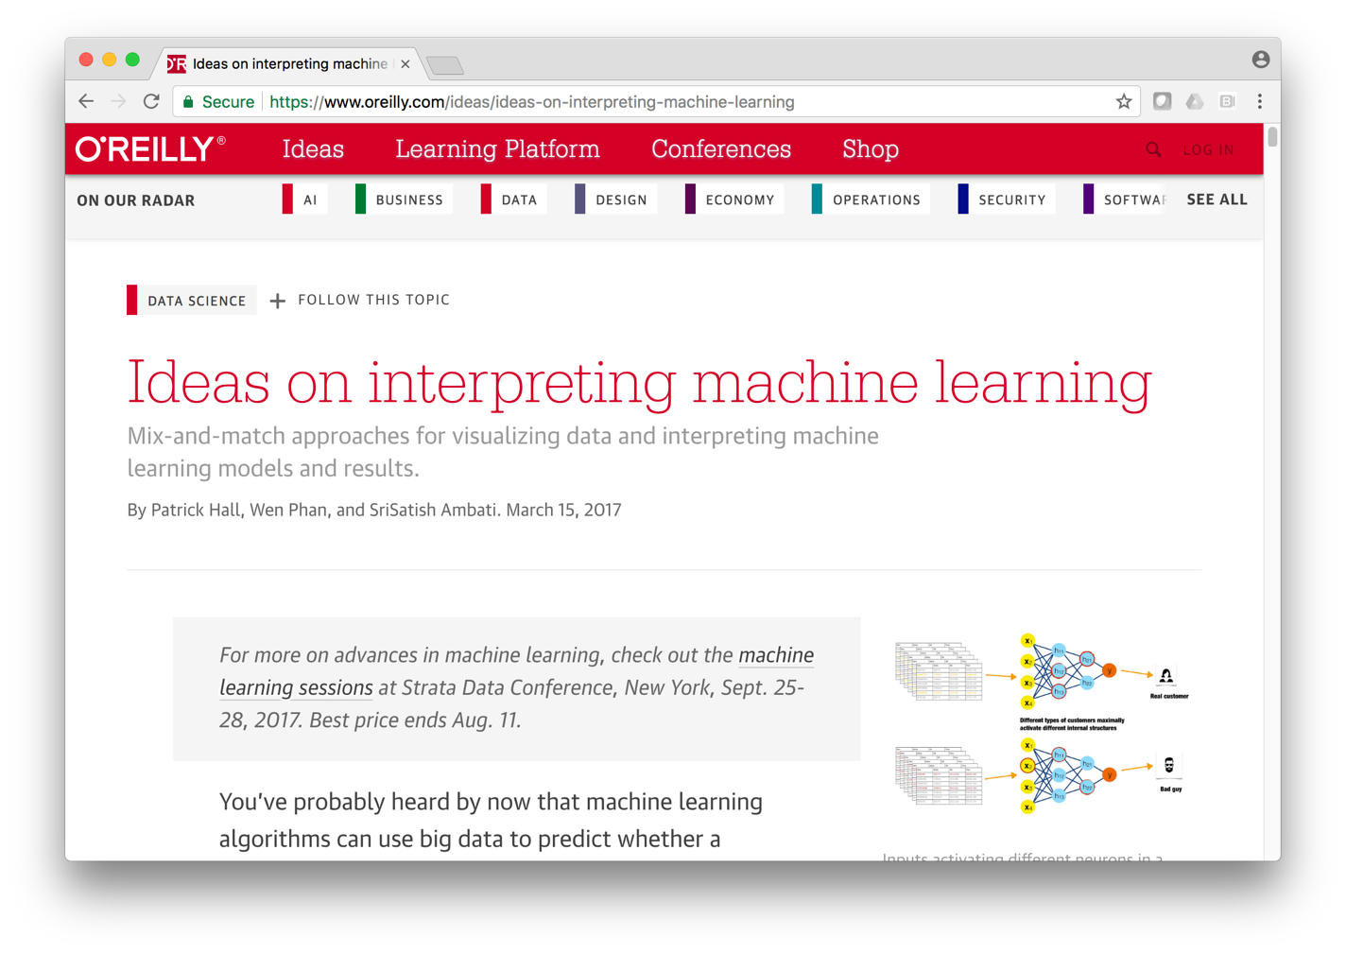
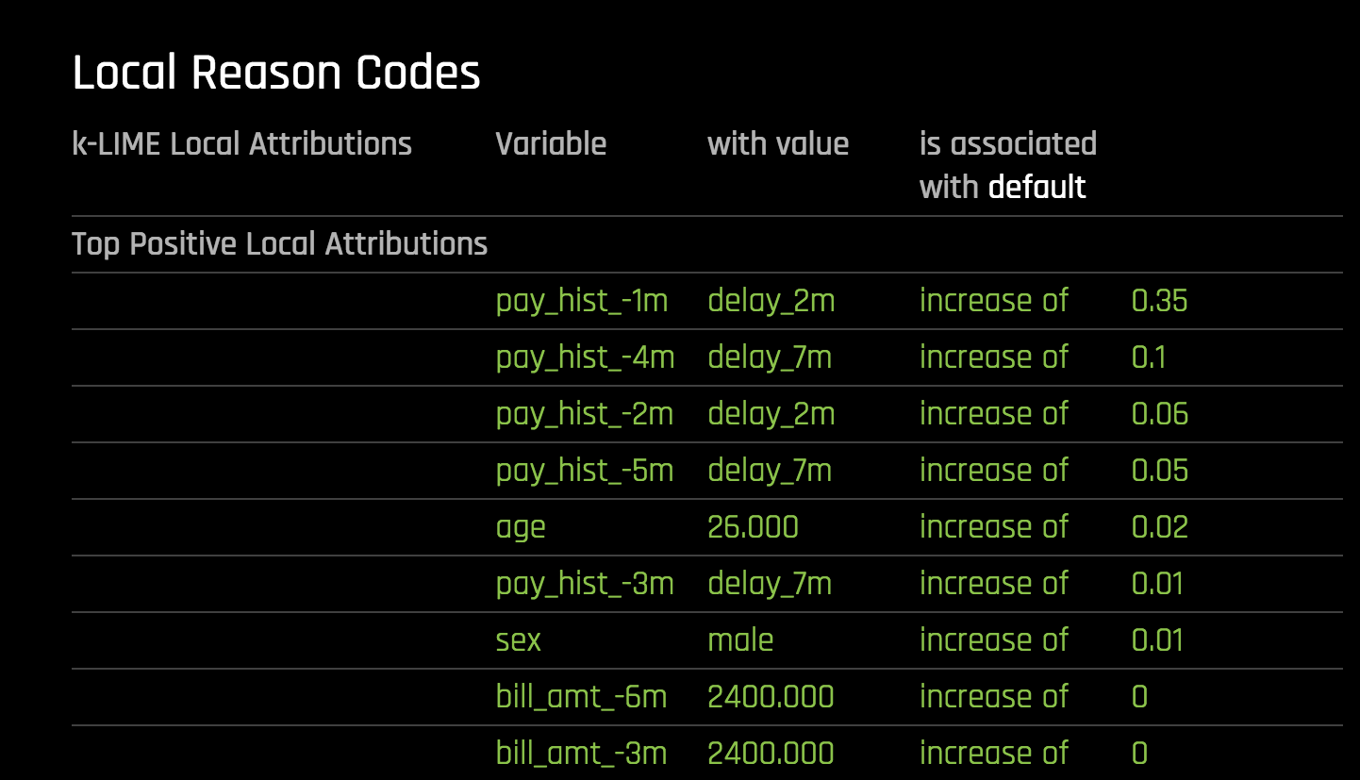
Interpretable: Explainable Machine Learning
https://www.oreilly.com/ideas/ideas-on-interpreting-machine-learning

Slide 57
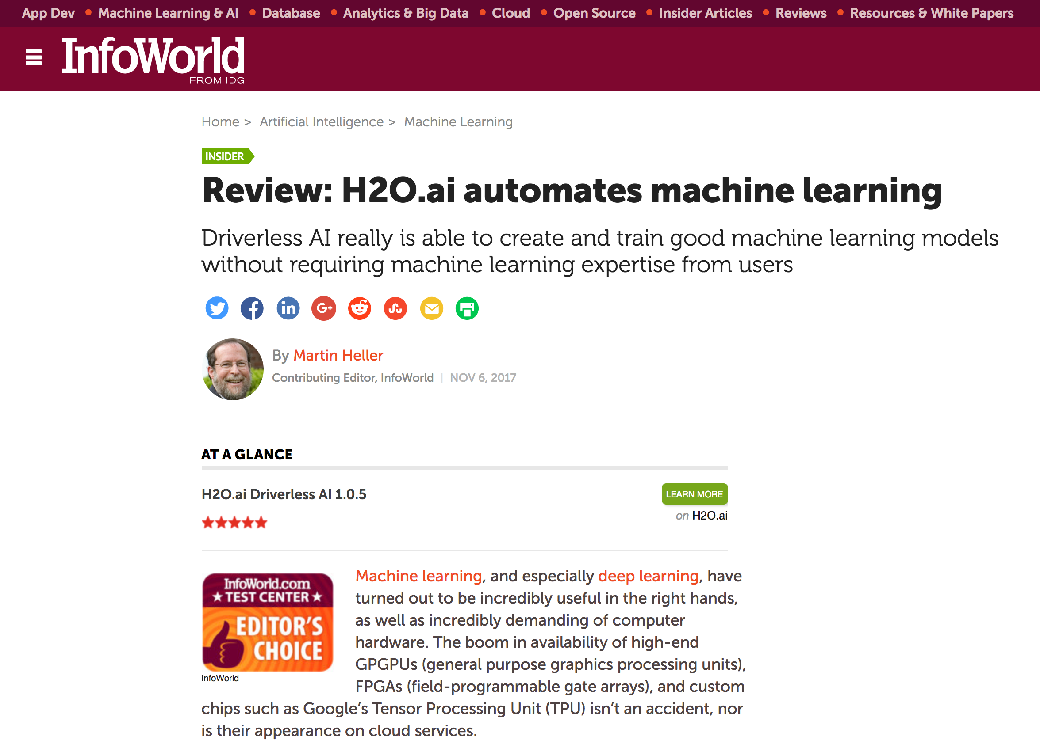
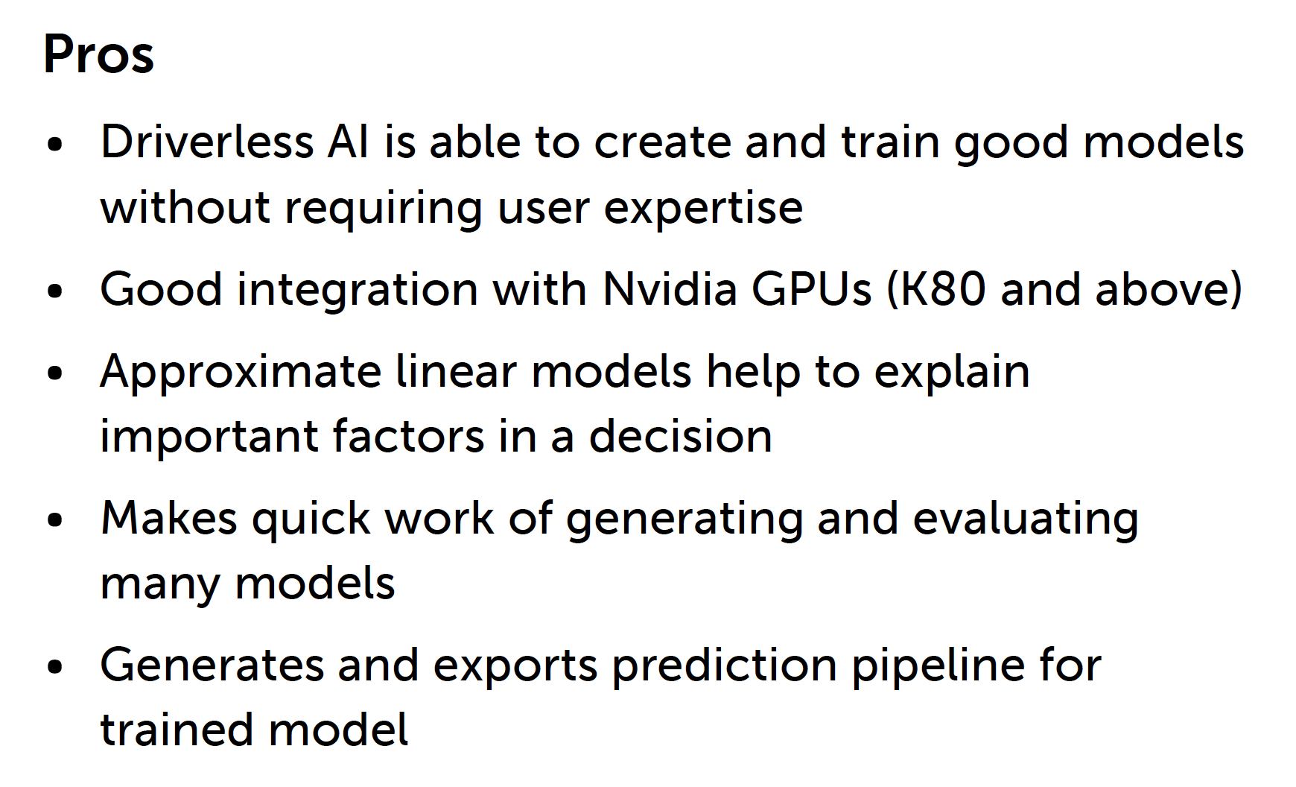

External Review
https://www.infoworld.com/article/3236048/machine-learning/review-h2oai-automates-machine-learning.html

Slide 58
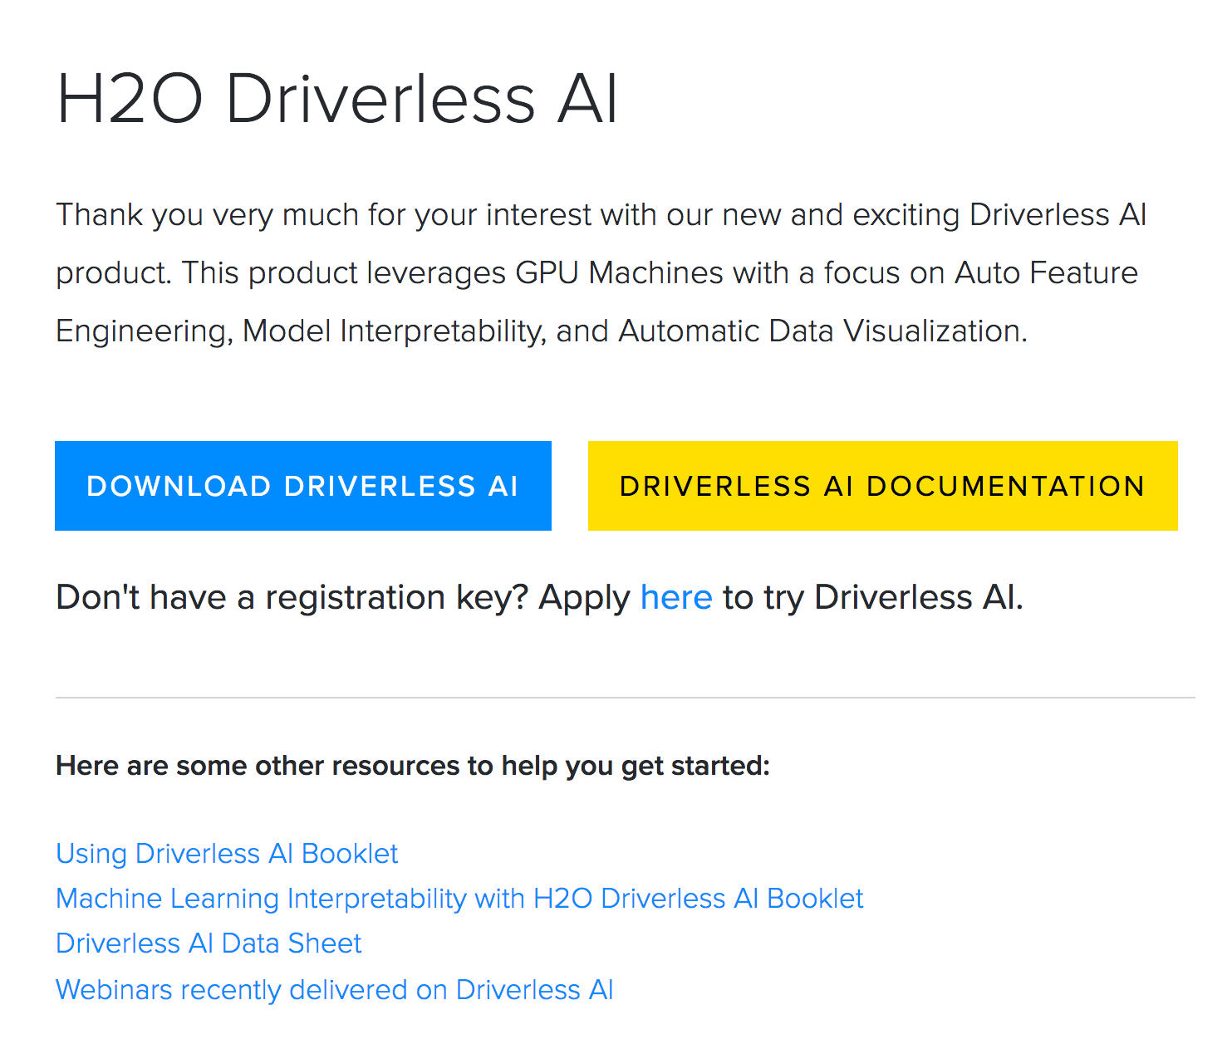
www.h2o.ai/driverless-ai-download/
Docker Image
30-Day Free Trial

Slide 59
Demo: Credit Card Default Risk

Slide 60
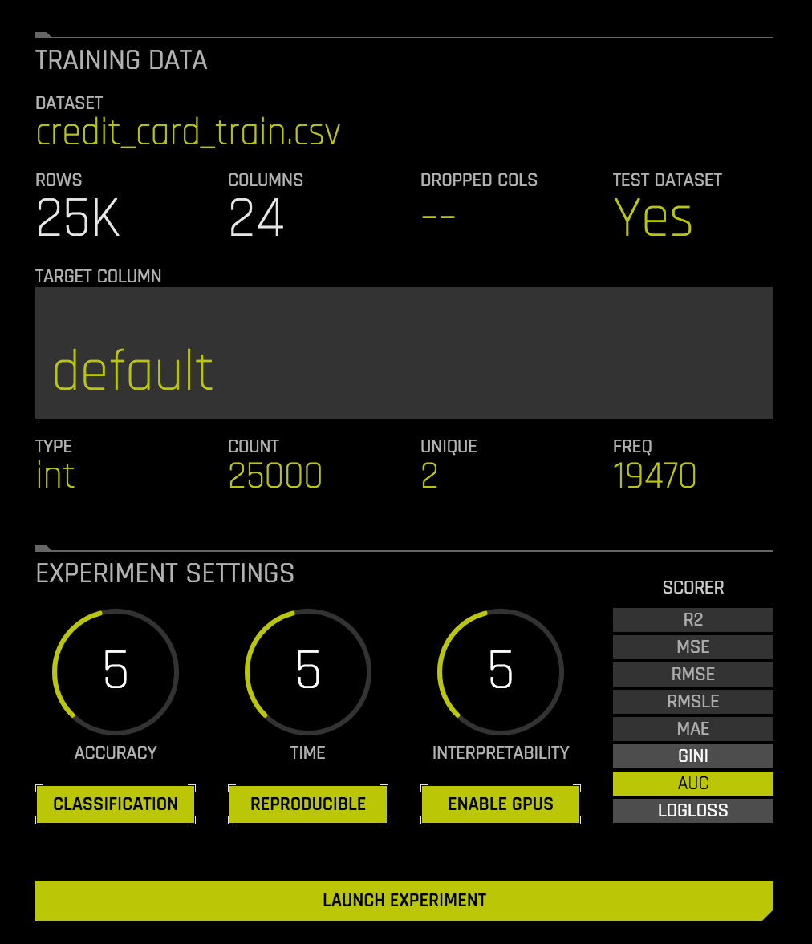
Training Data
Optional Test Set
Target
Simple Settings
Select Metric
That’s it!

Slide 61
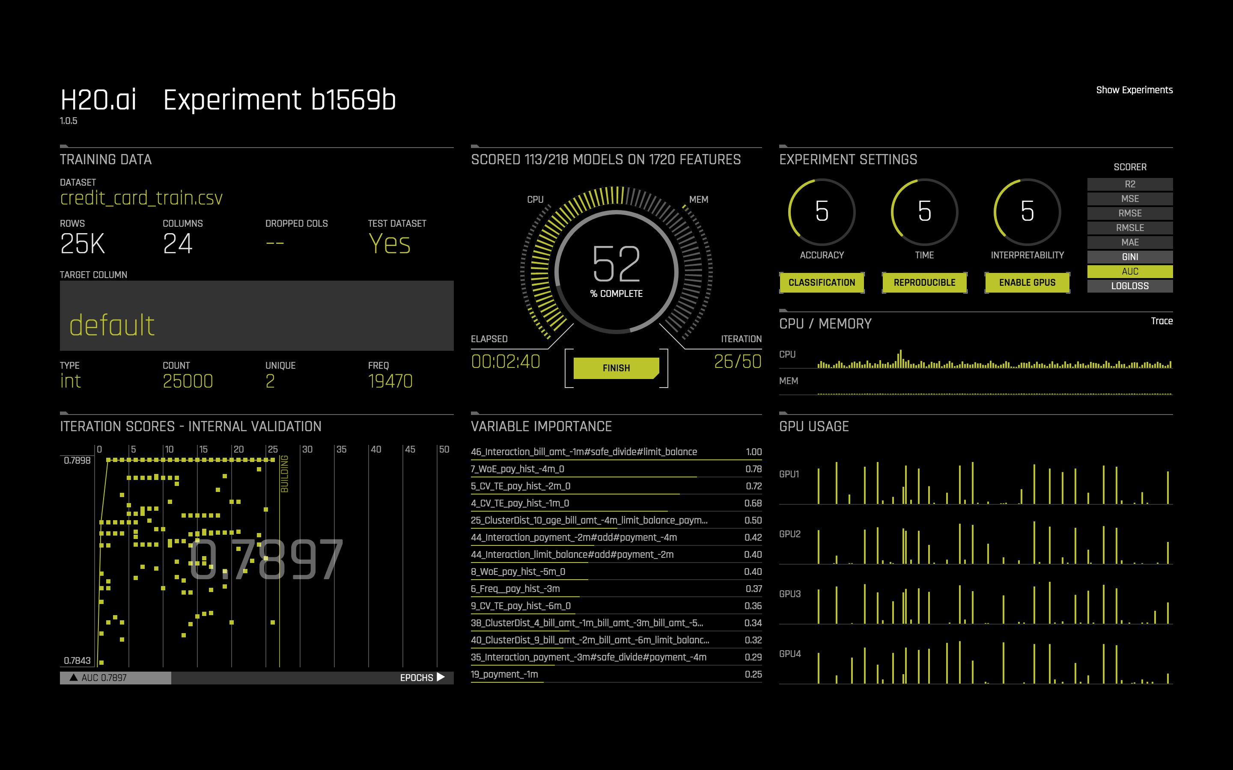
Trying out Different Sets of Features
Auto Feature Engineering
Using both CPUs & GPUs

Slide 62
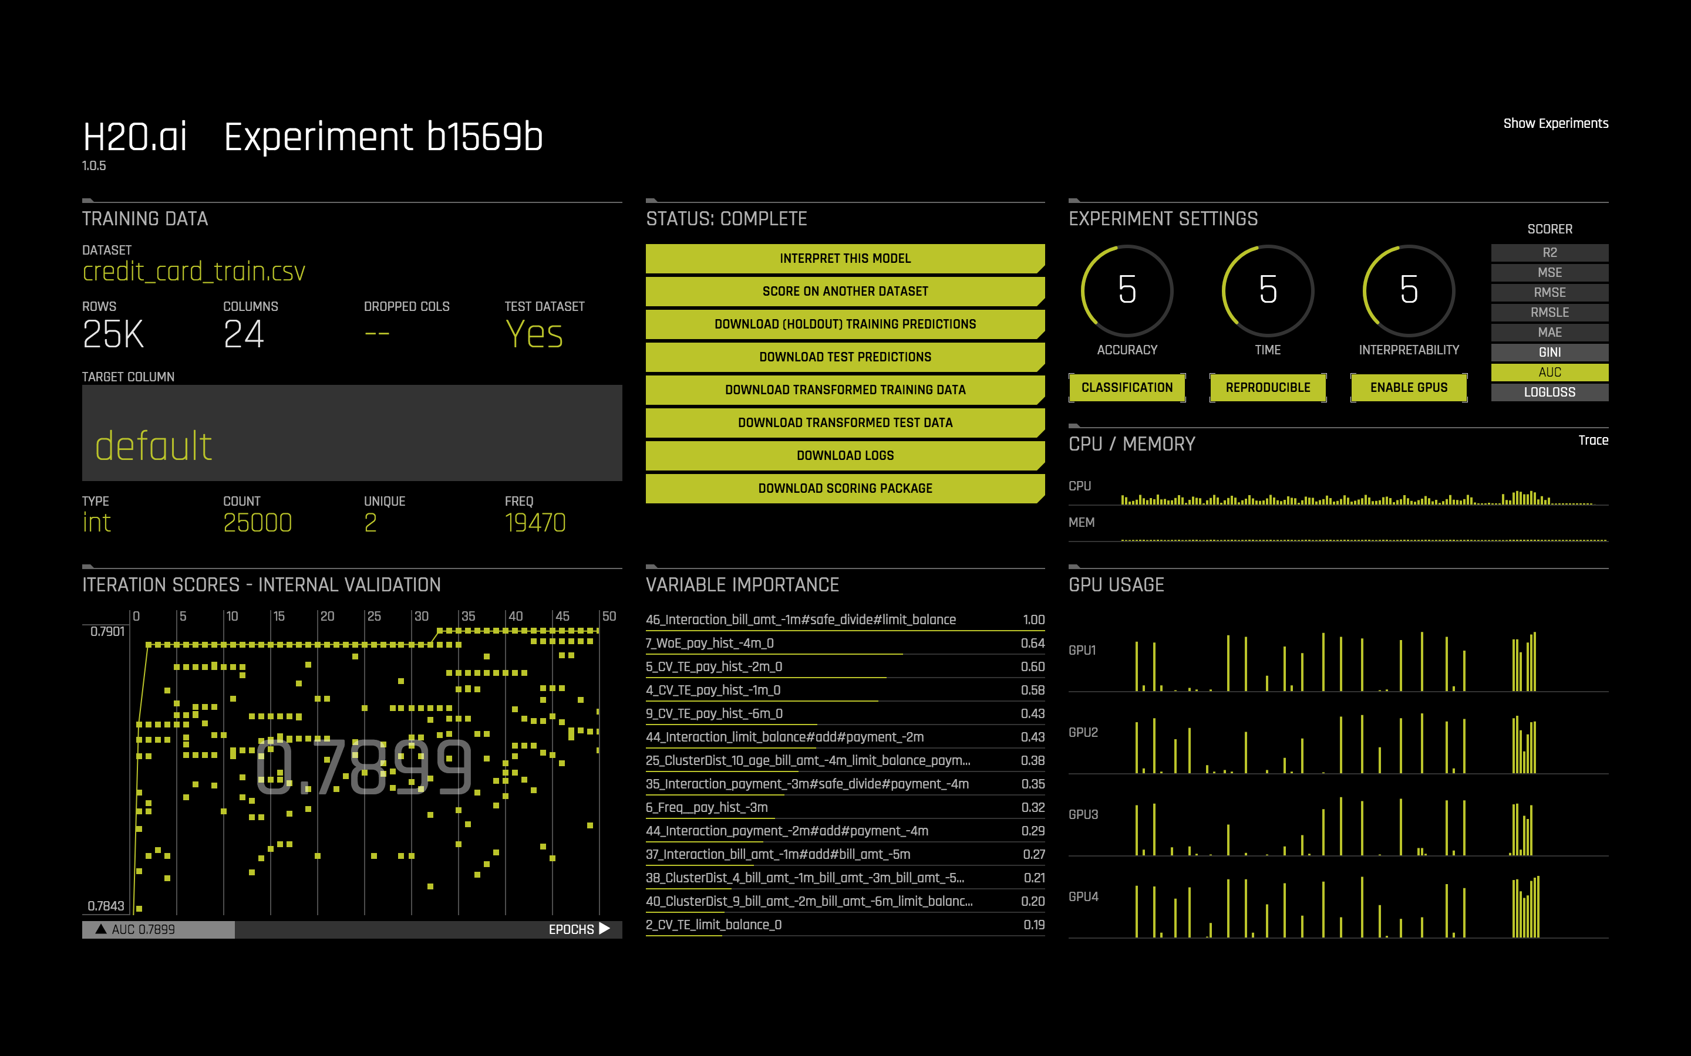
Options for Interpretation, Scoring, Logs, Pipeline

Slide 63
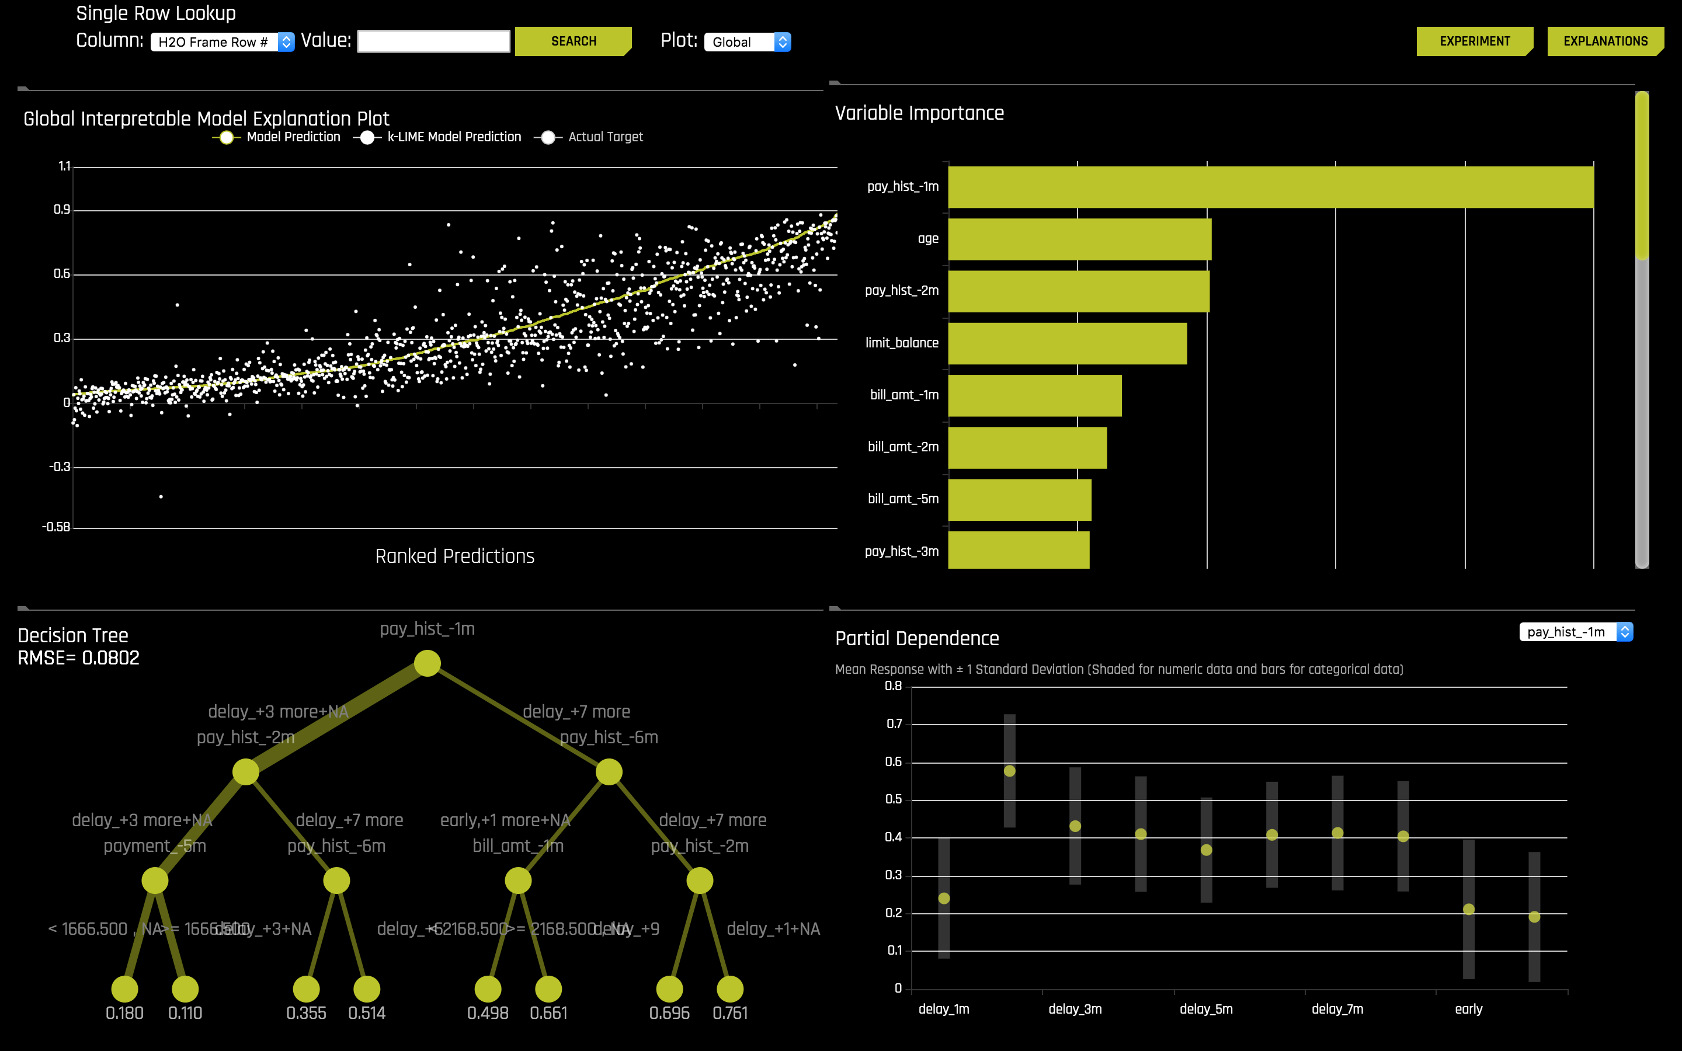

Slide 64
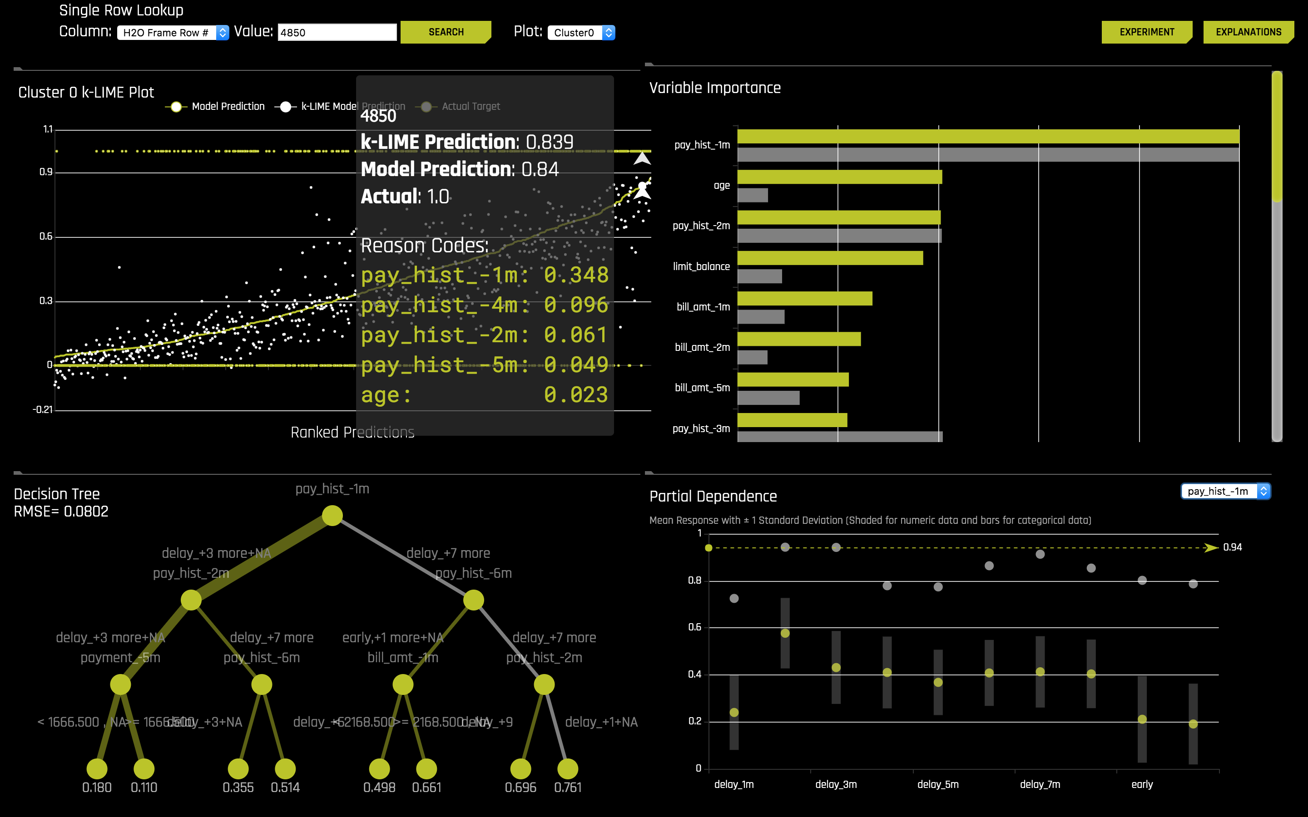
Zoom into individual records
Explain how inputs lead to outcome with a simple decision tree

Slide 65
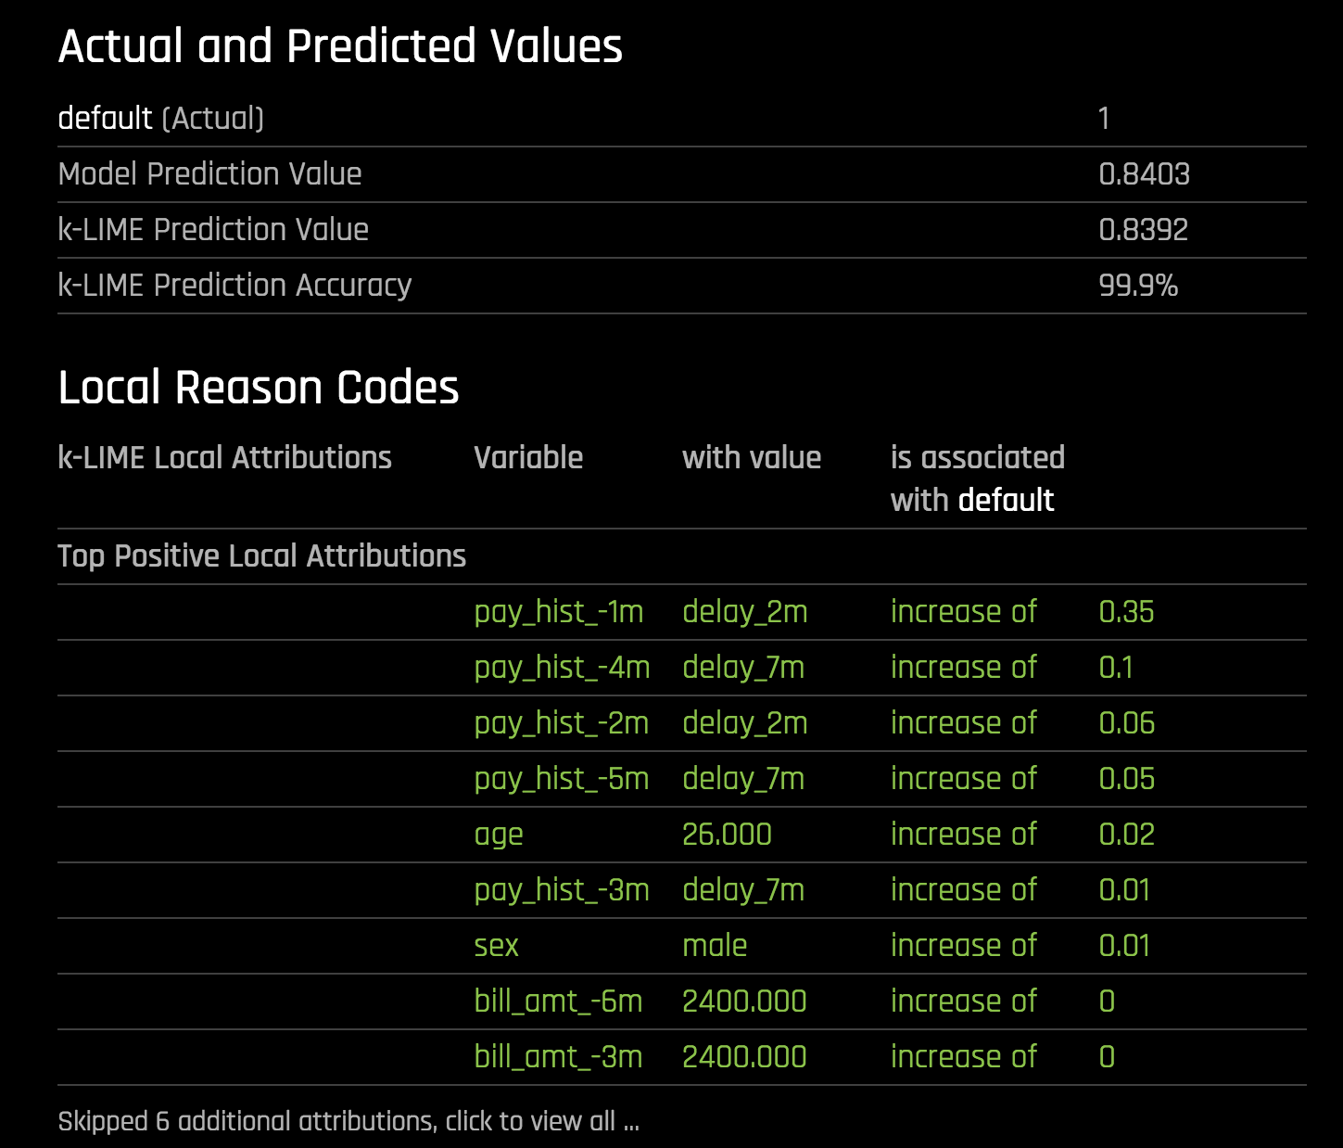
Turn decision tree into reason codes

Slide 66

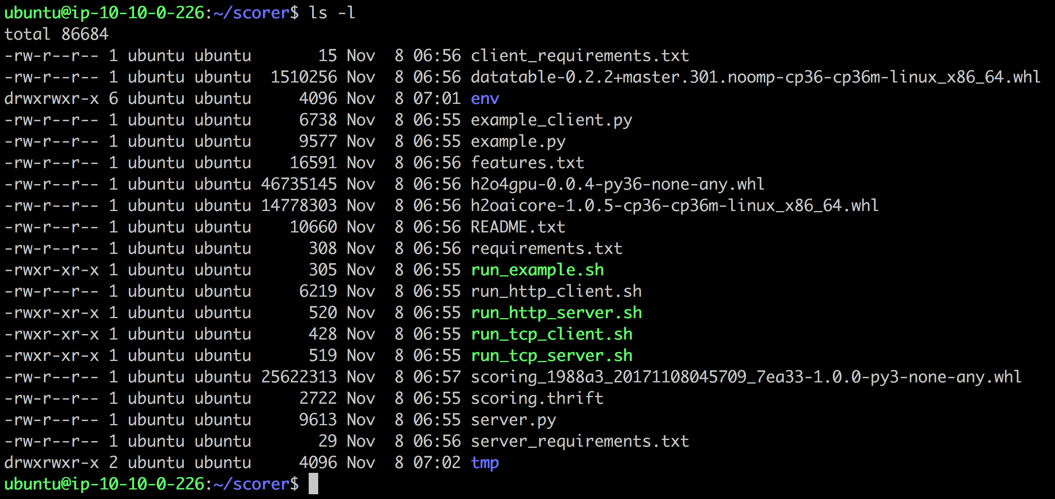
Download Pipeline

Slide 67
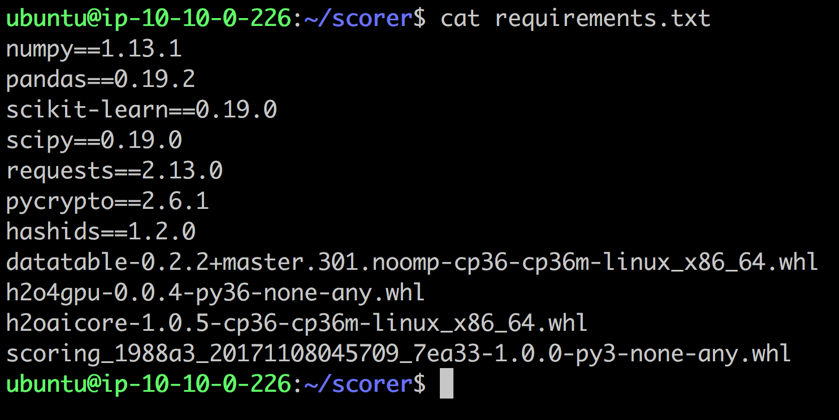
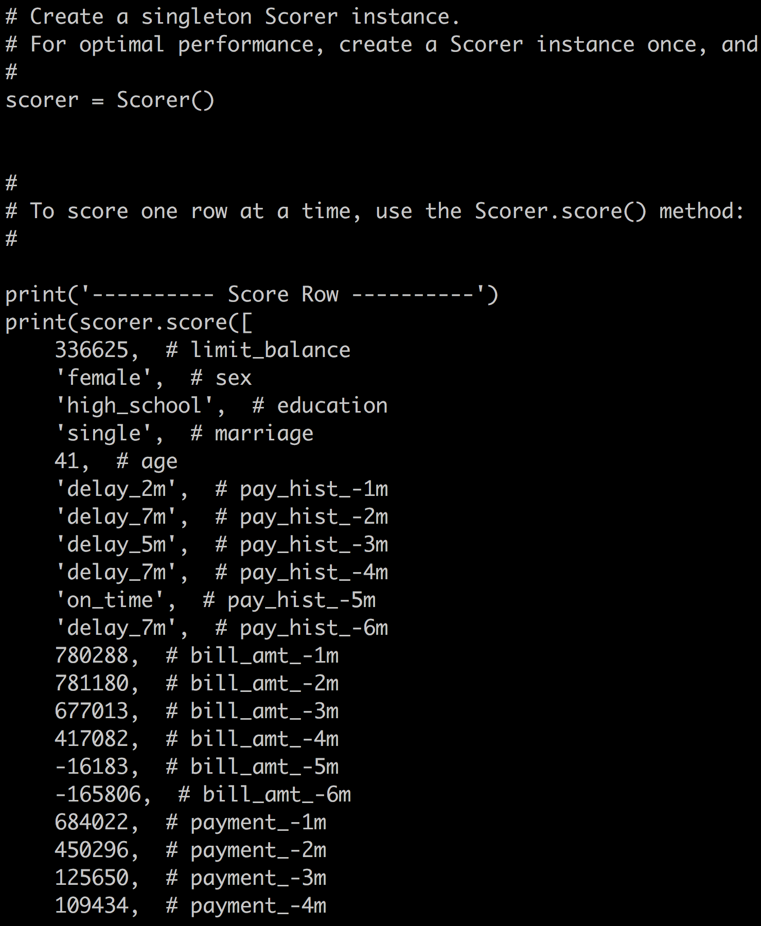
Standalone Python Package

Slide 68
Q & A

